Slide 1


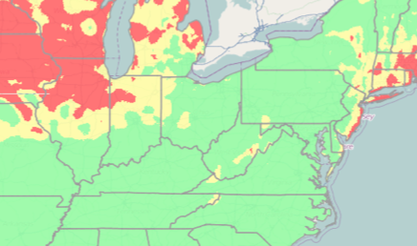




Atmospheric coherent structures and aerobiological invasions
Shane Ross
Joint with Amir BozorgMagham, Phanindra Tallapragada,
Binbin Lin, A.J. Prussin, David Schmale
Virginia Tech, Department of Engineering Science and Mechanics

Slide 2
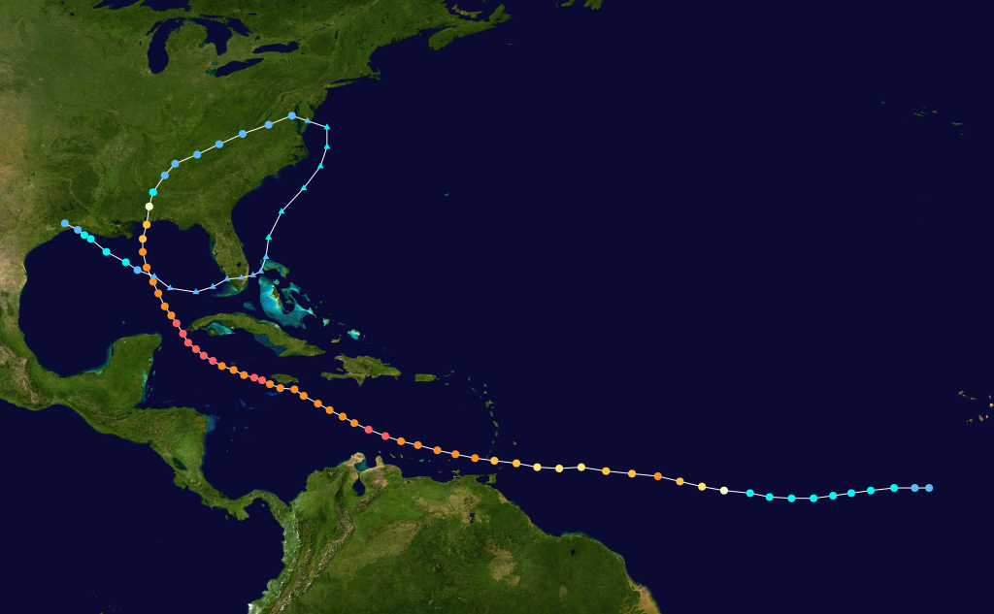
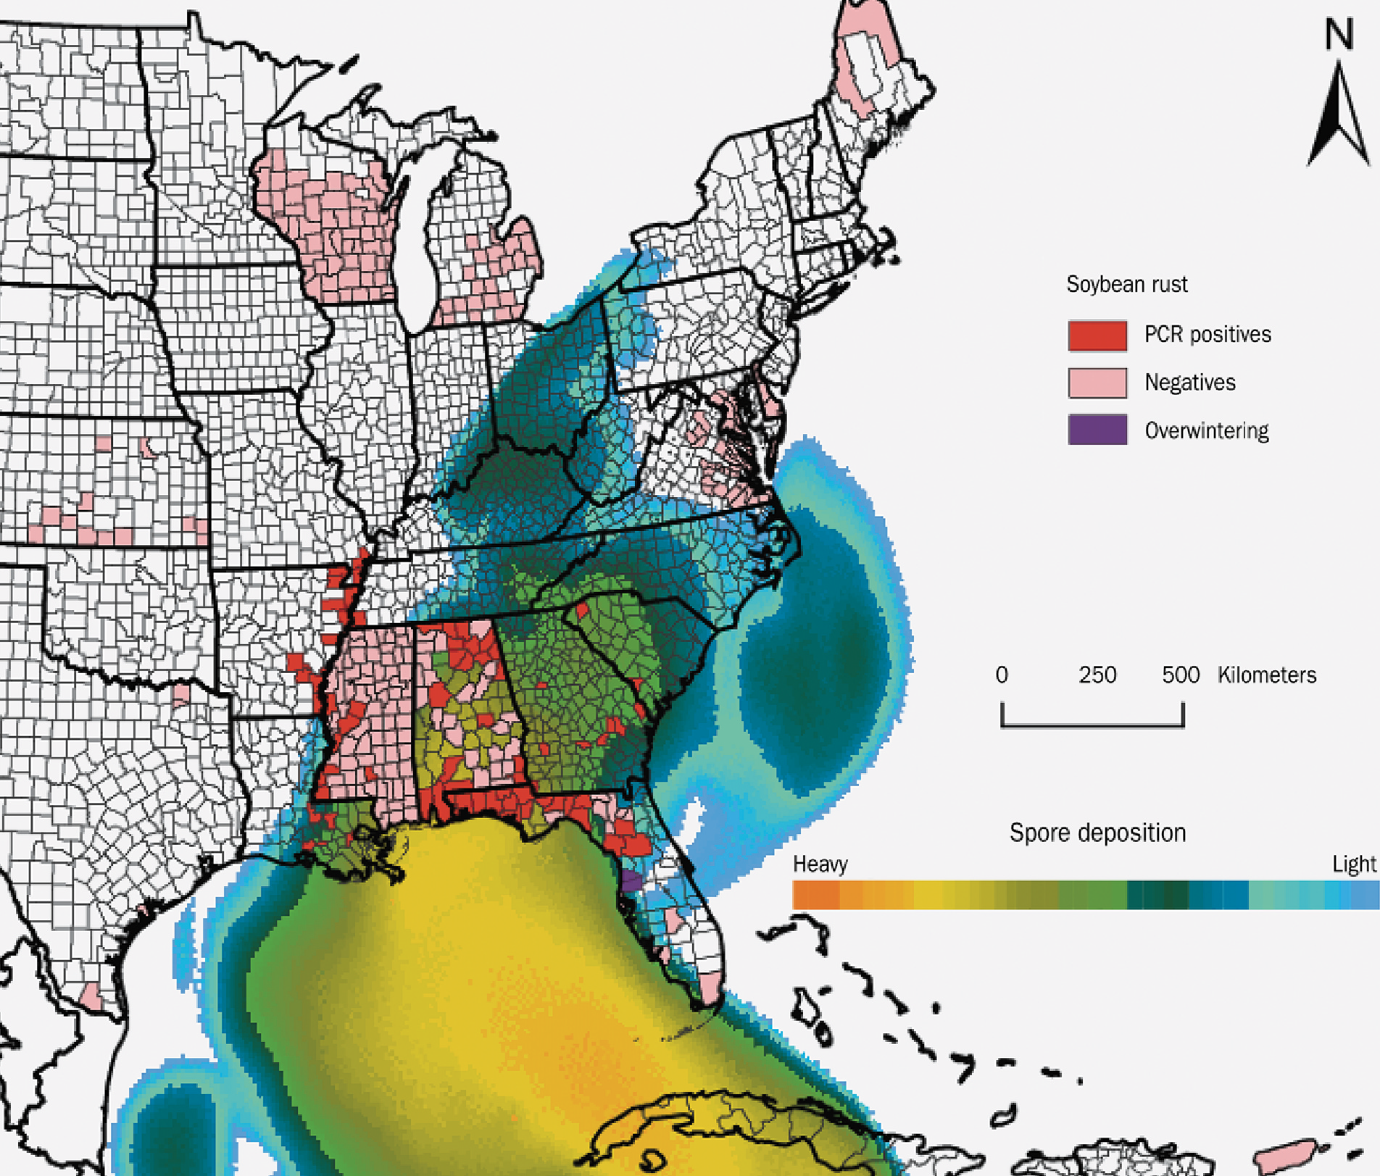
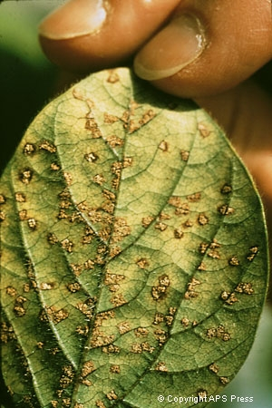
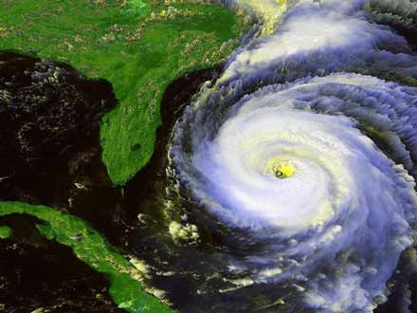
Invasive species riding the atmosphere
2004
Hurricane Ivan (2004)
brought new crop disease (soybean rust) to U.S.
From Rio Cauca region of Colombia
Coastal flow
Red=infected US regions

Slide 3
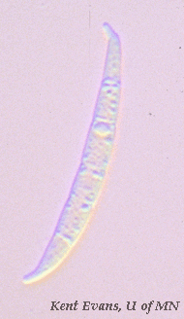
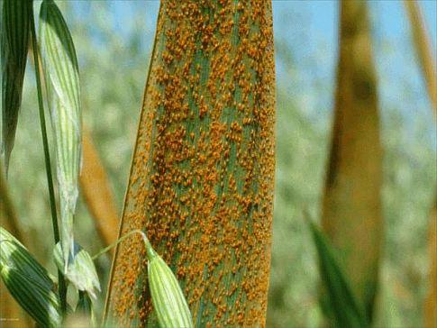
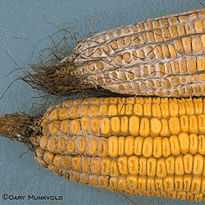
Invasive species riding the atmosphere
2004
Hurricane Ivan (2004)
brought new crop disease (soybean rust) to U.S.
From Rio Cauca region of Colombia
Coastal flow
Cost of invasive organisms is
>$100 billion per year in U.S.
Airborne pathogen

Slide 4
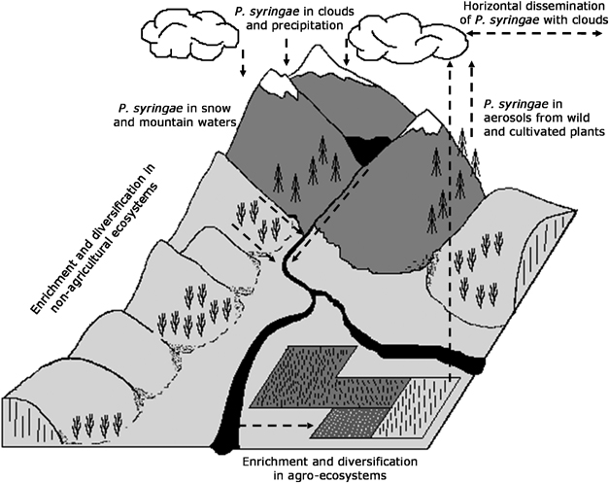
Plant pathogens linked to water cycle
What you grow affects local microclimate
(Cindy Morris, INRA)

Slide 5
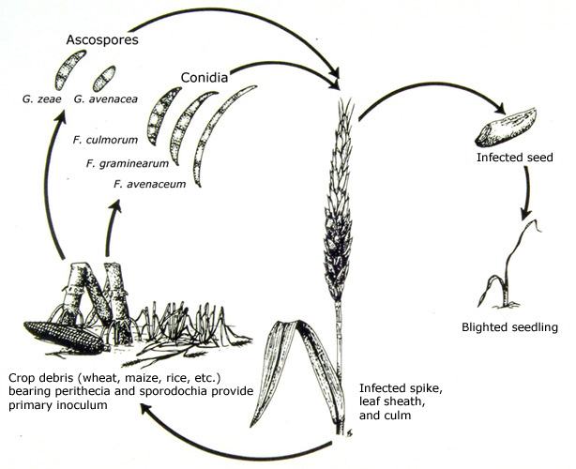
Atmospheric transport of microorganisms
e.g., Fusarium fungal spores
Spore production, release, escape from surface
Long-range transport (time-scale hours to days)
Deposition, infection efficiency, host susceptibility
Schmale & Bergstrom [2003]

Slide 6
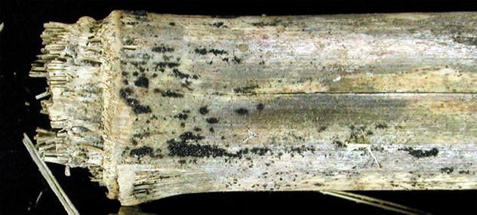
Atmospheric transport of microorganisms
e.g., Fusarium fungal spores
Spore production, release, escape from surface
Long-range transport (time-scale hours to days)
Deposition, infection efficiency, host susceptibility
Schmale & Bergstrom [2003], Trail et al. [2005]

Slide 7
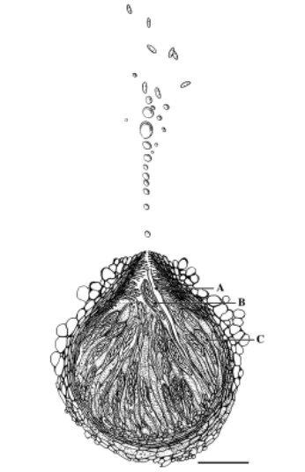

Atmospheric transport of microorganisms
e.g., Fusarium fungal spores
Spore production, release, escape from surface
Long-range transport (time-scale hours to days)
Deposition, infection efficiency, host susceptibility
Schmale & Bergstrom [2003], Trail et al. [2005]

Slide 8
Atmospheric transport of microorganisms
spore
~100 μm
e.g., Fusarium fungal spores
Spore production, release, escape from surface
Long-range transport (time-scale hours to days)
Deposition, infection efficiency, host susceptibility
Schmale & Bergstrom [2003], Trail et al. [2005]

Slide 9
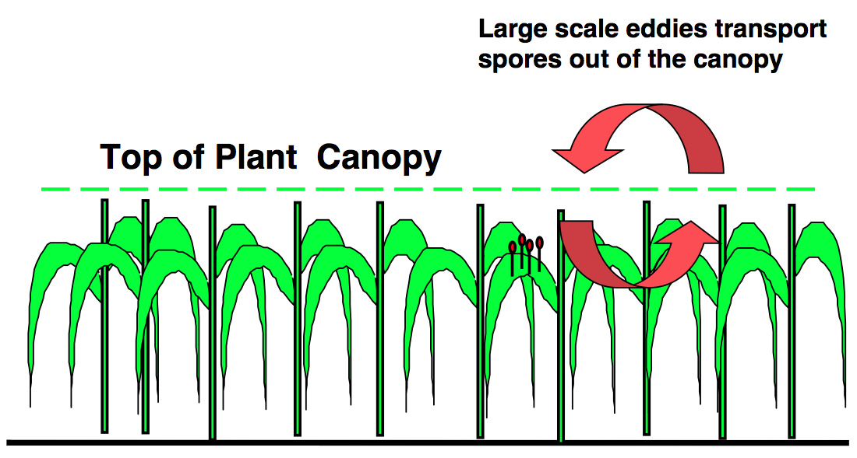
Atmospheric transport of microorganisms
Spore production, release, escape from surface
Long-range transport (time-scale hours to days)
Deposition, infection efficiency, host susceptibility
Aylor [1999]

Slide 10
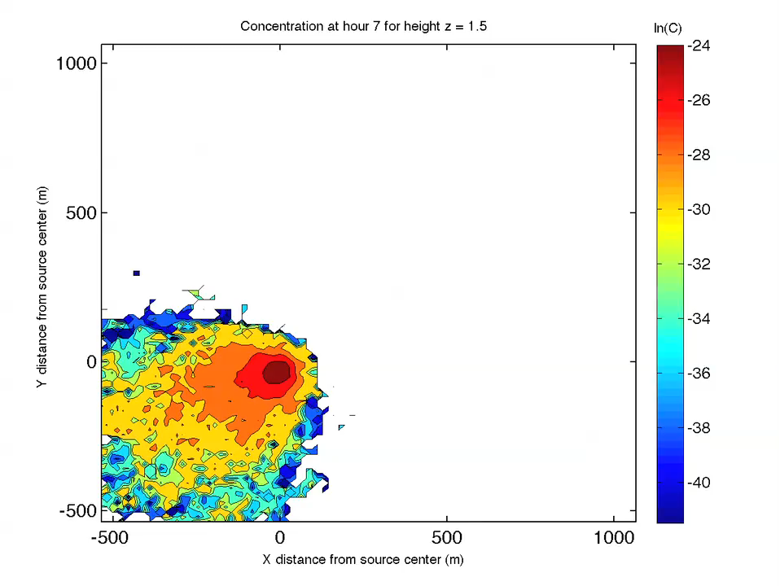
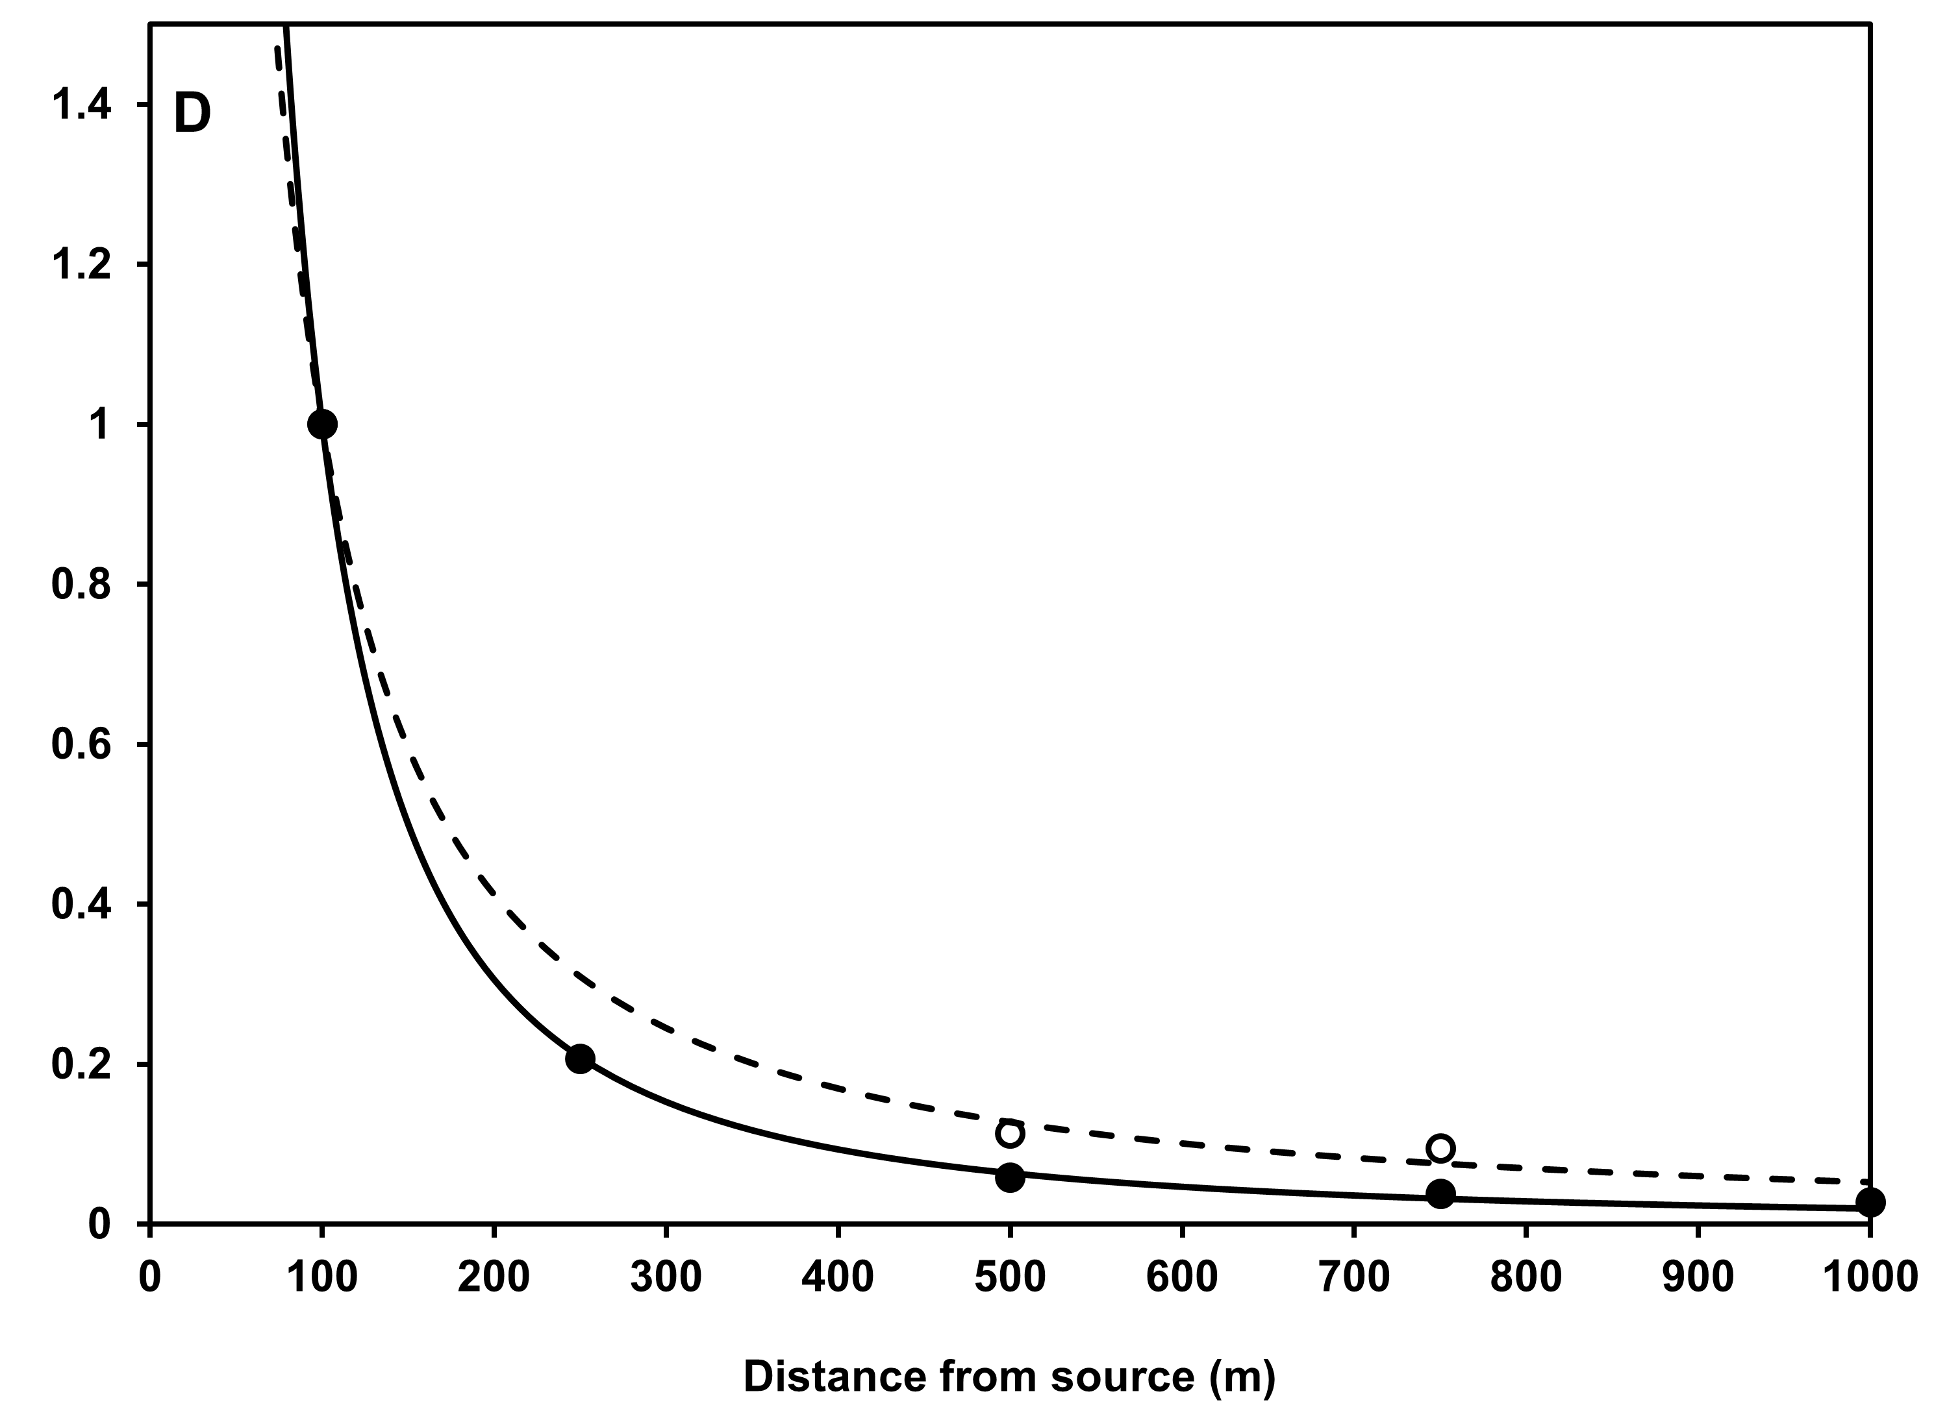
Atmospheric transport of microorganisms
Plume follows changing wind direction
Temporally varying source strength
Experimentally derived
dispersal kernels
Spore production, release, escape from surface
Long-range transport (time-scale hours to days)
Deposition, infection efficiency, host susceptibility
Prussin et al. [2014a,b] Plant Disease

Slide 11
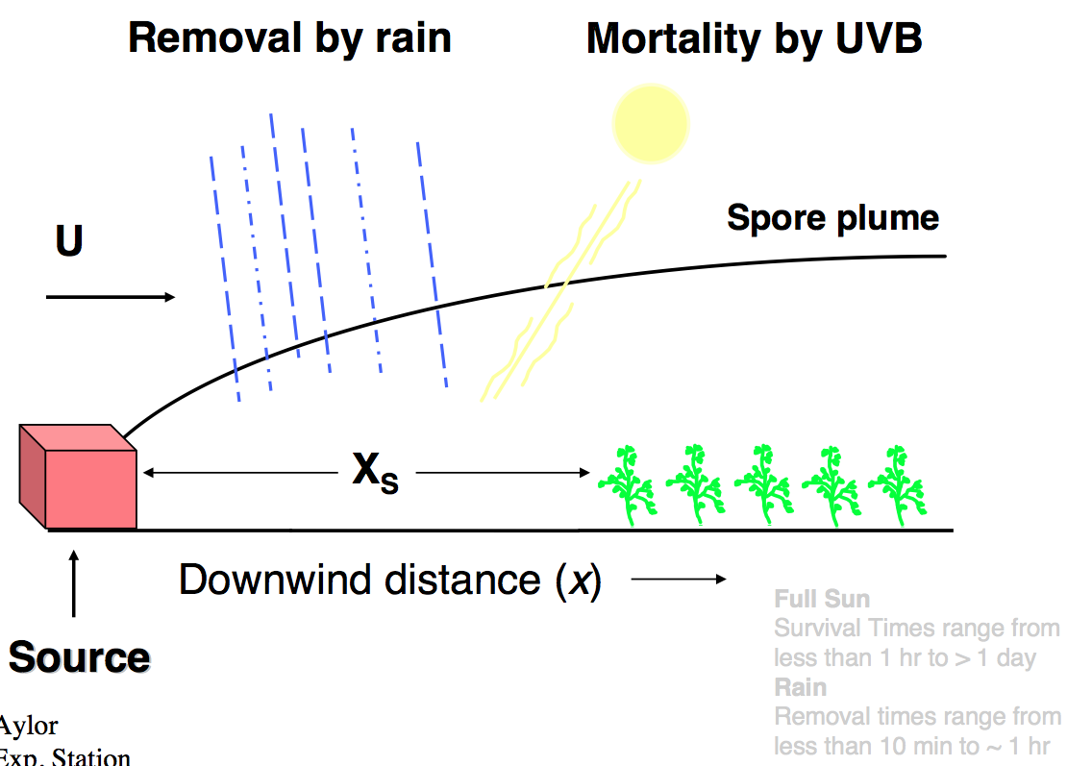
Atmospheric transport of microorganisms
Spore production, release, escape from surface
Long-range transport (time-scale hours to days)
Deposition, infection efficiency, host susceptibility
Aylor [1999]; Prussin et al [2014]

Slide 12
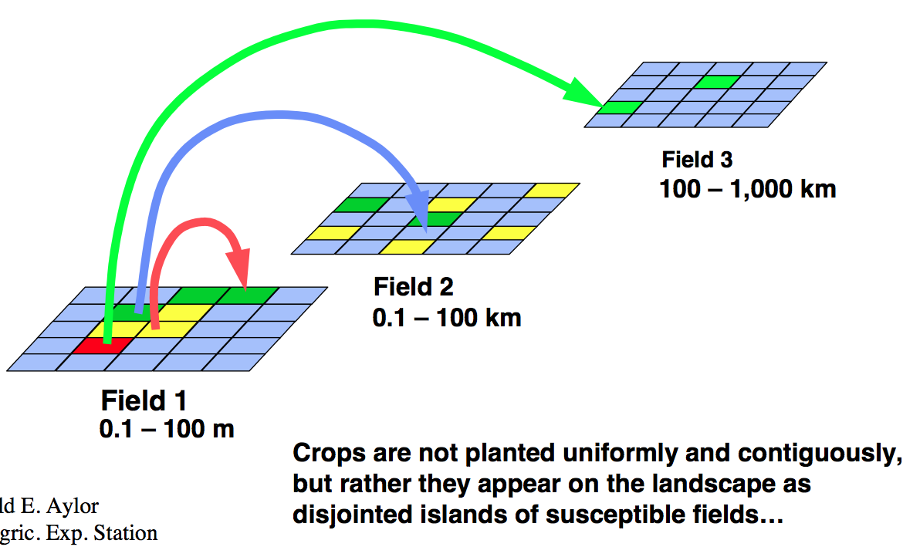
Atmospheric transport of microorganisms
Deposition patterns can be patchy
Spore production, release, escape from surface
Long-range transport (time-scale hours to days)
Deposition, infection efficiency, host susceptibility
Aylor [1999]

Slide 13
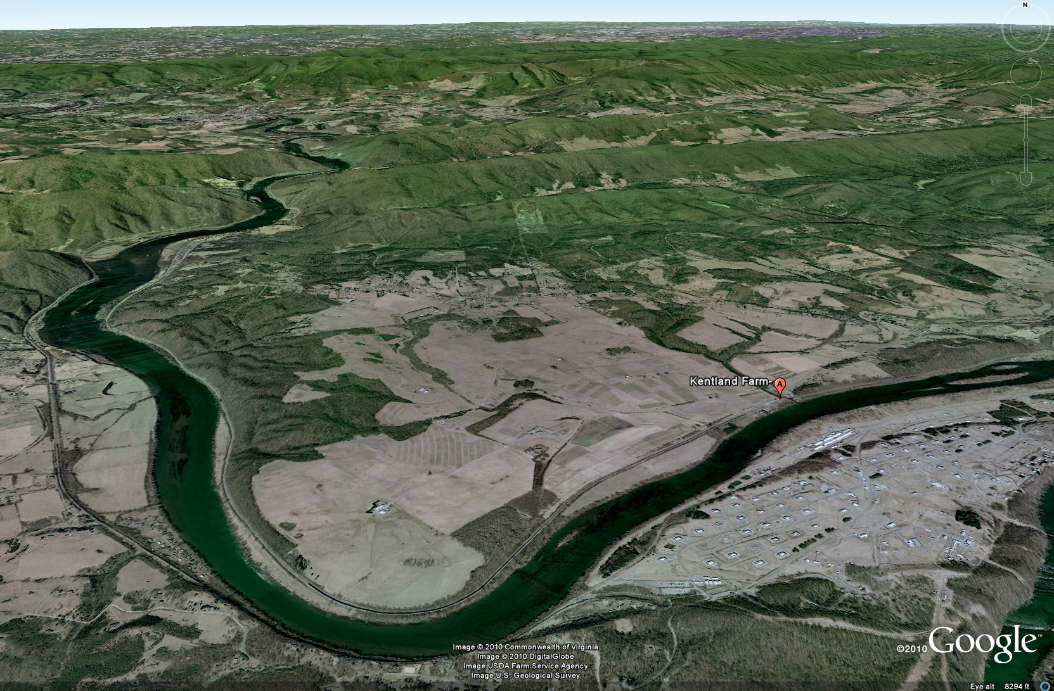
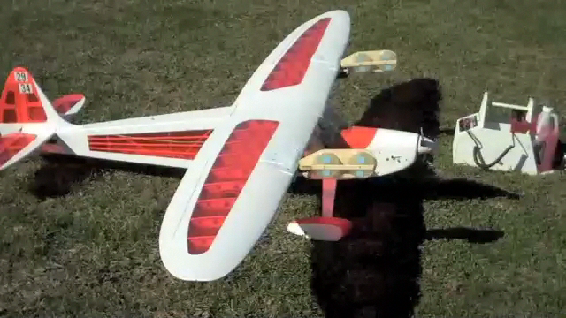
Aerial sampling drones:
40 m – 400 m altitude
(David Schmale’s group)
Samples collected over 10-30 minute intervals at constant elevation (e.g., 400m) above ground level
Notes:
In general, a layer of air adjacent to a bounding surface. Specifically, the term most often refers to the planetary boundary layer, which is the layer within which the effects of friction are significant. For the earth, this layer is considered to be roughly the lowest one or two kilometers of the atmosphere. It is within this layer that temperatures are most strongly affected by daytime insolation and nighttime radiational cooling, and winds are affected by friction with the earth's surface. The effects of friction die out gradually with height, so the "top" of this layer cannot be defined exactly.
There is a thin layer immediately above the earth's surface known as the surface boundary layer (or simply the surface layer). This layer is only a part of the planetary boundary layer, and represents the layer within which friction effects are more or less constant throughout (as opposed to decreasing with height, as they do above it). The surface boundary layer is roughly 10 meters thick, but again the exact depth is indeterminate. Like friction, the effects of insolation and radiational cooling are strongest within this layer.

Slide 14
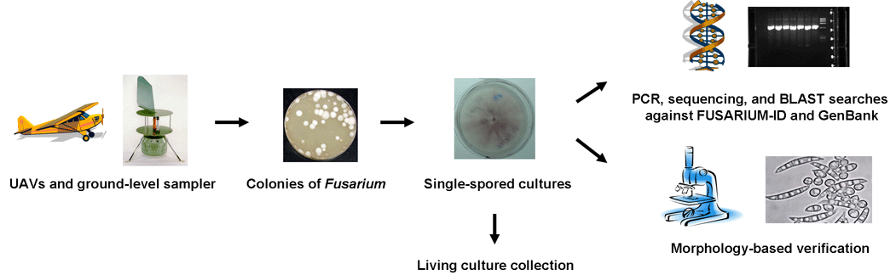
Collect spores, identify species
Notes:
Fusarium colonies (white circles) enumerated from four atmospheric sample plates collected with an autonomous UAV 100 m above the surface of the earth at Virginia Tech’s Kentland Farm [28]. Sample plates contained a Fusarium selective medium.

Slide 15
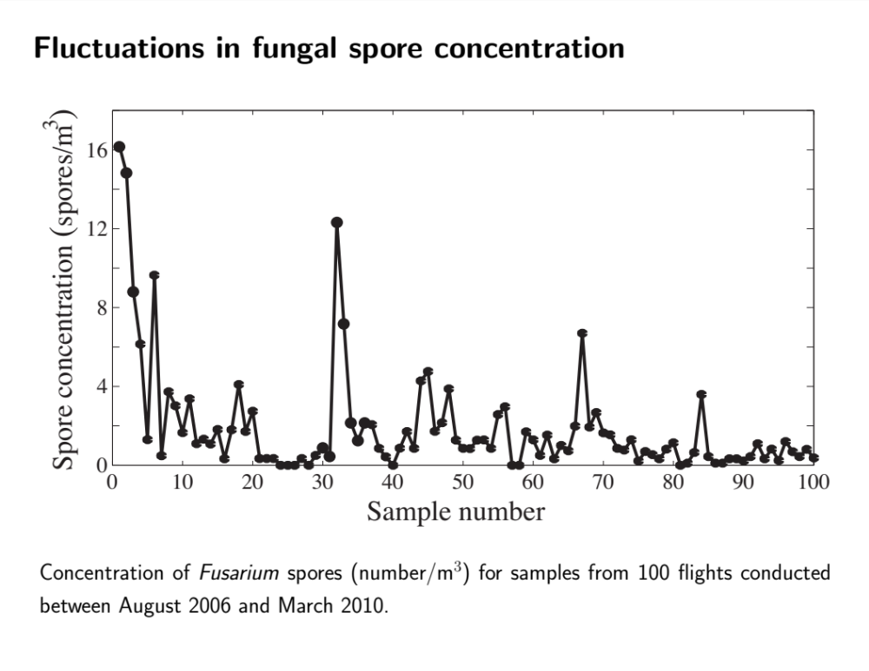
A time series at a single sampling location.
Total spore concentration (all species).

Slide 16
Sources are unknown
If sources were known, could model plume

Slide 17
Sources are unknown
We are sampling from many sources

Slide 18
Sources are unknown
We are sampling from many sources
We are sampling a superposition of plumes from various distant sources (e.g., diseased fields)
Spores are airborne long enough to be mixed a bit by atmospheric transport structures

Slide 19
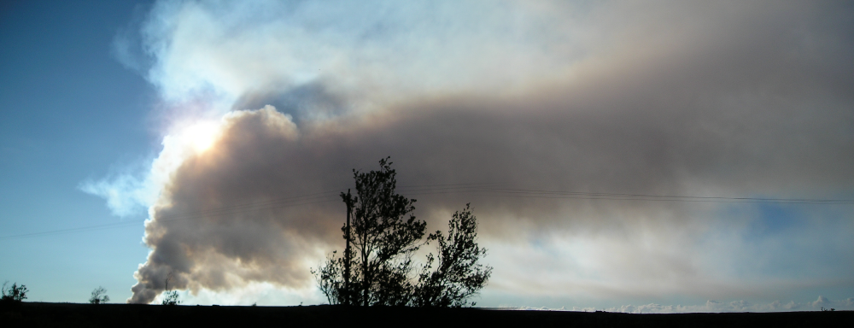
Sources are unknown
We are sampling from many sources
We are sampling a superposition of plumes from various distant sources (e.g., diseased fields)
Spores are airborne long enough to be mixed a bit by atmospheric transport structures
e.g., can imagine ‘invisible’ smoke plumes
Notes:
Fusarium colonies (white circles) enumerated from four atmospheric sample plates collected with an autonomous UAV 100 m above the surface of the earth at Virginia Tech’s Kentland Farm [28]. Sample plates contained a Fusarium selective medium.

Slide 20
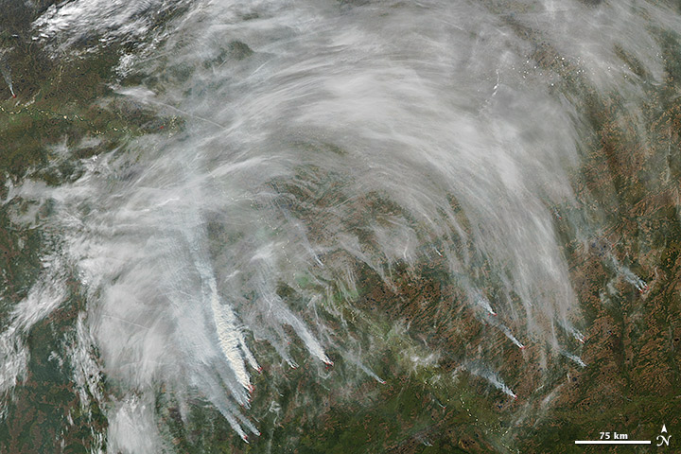
Sources are unknown
We are sampling from many sources
We are sampling a superposition of plumes from various distant sources (e.g., diseased fields)
Spores are airborne long enough to be mixed a bit by atmospheric transport structures
e.g., can imagine ‘invisible’ smoke plumes
Notes:
Fusarium colonies (white circles) enumerated from four atmospheric sample plates collected with an autonomous UAV 100 m above the surface of the earth at Virginia Tech’s Kentland Farm [28]. Sample plates contained a Fusarium selective medium.

Slide 21
Sources are unknown
We are sampling from many sources
We are sampling a superposition of plumes from various distant sources (e.g., diseased fields)
Spores are airborne long enough to be mixed a bit by atmospheric transport structures
Sample here
A
D
B
C
e.g., can imagine ‘invisible’ smoke plumes
Notes:
Fusarium colonies (white circles) enumerated from four atmospheric sample plates collected with an autonomous UAV 100 m above the surface of the earth at Virginia Tech’s Kentland Farm [28]. Sample plates contained a Fusarium selective medium.

Slide 22
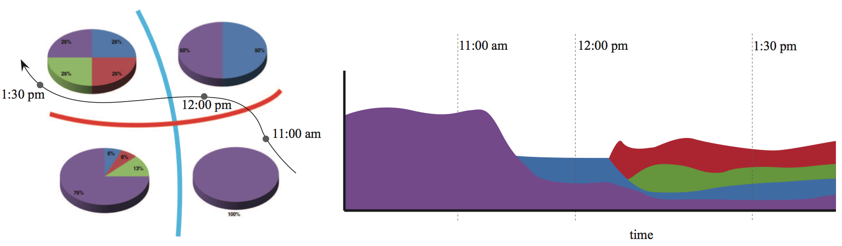
Sources are unknown
We are sampling from many sources
We are sampling a superposition of plumes from various distant sources (e.g., diseased fields)
Spores are airborne long enough to be mixed a bit by atmospheric transport structures
Sample here
Pop.
structure
A
D
B
C
B
C
A
D
e.g., can imagine ‘invisible’ smoke plumes
Time
Notes:
Fusarium colonies (white circles) enumerated from four atmospheric sample plates collected with an autonomous UAV 100 m above the surface of the earth at Virginia Tech’s Kentland Farm [28]. Sample plates contained a Fusarium selective medium.

Slide 24
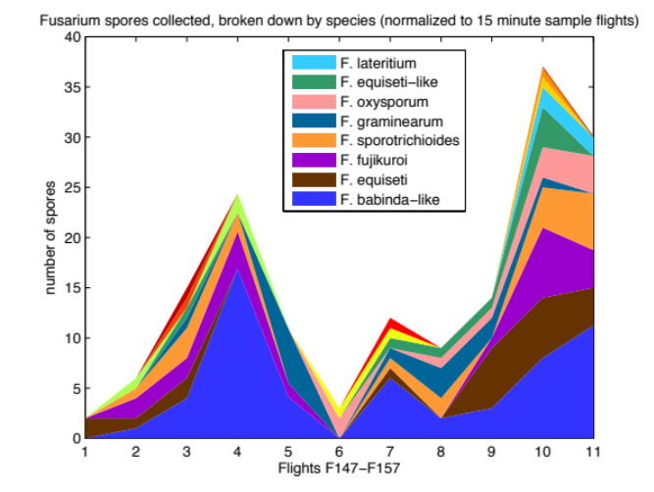
Considering all fungal spores: can break down by species later ->

Slide 25
Spore impact on Petri dishes is an inhomogenous Poisson process with slowly varying intensity
Lin et al. [2012] Aerobiologia

Slide 26
Spore impact on Petri dishes is an inhomogenous Poisson process with slowly varying intensity
Sometimes significant variability over short timescales, unexplained by Poisson statistics
Lin et al. [2012] Aerobiologia

Slide 27
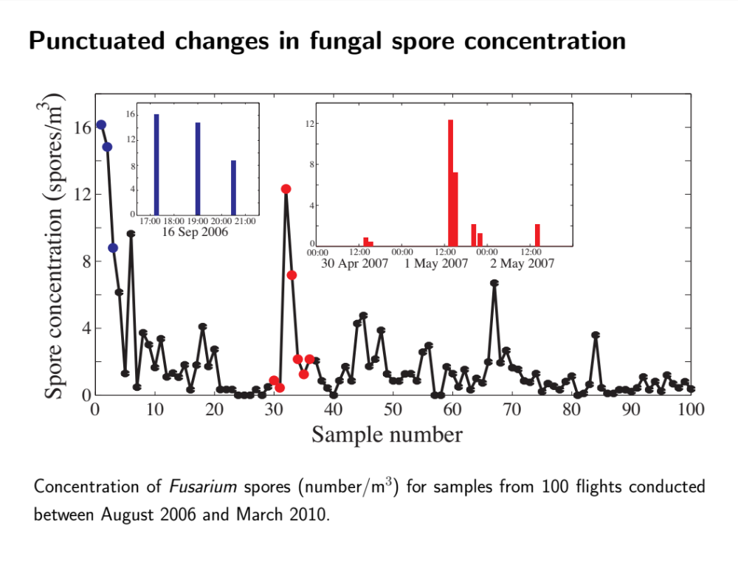

Slide 28
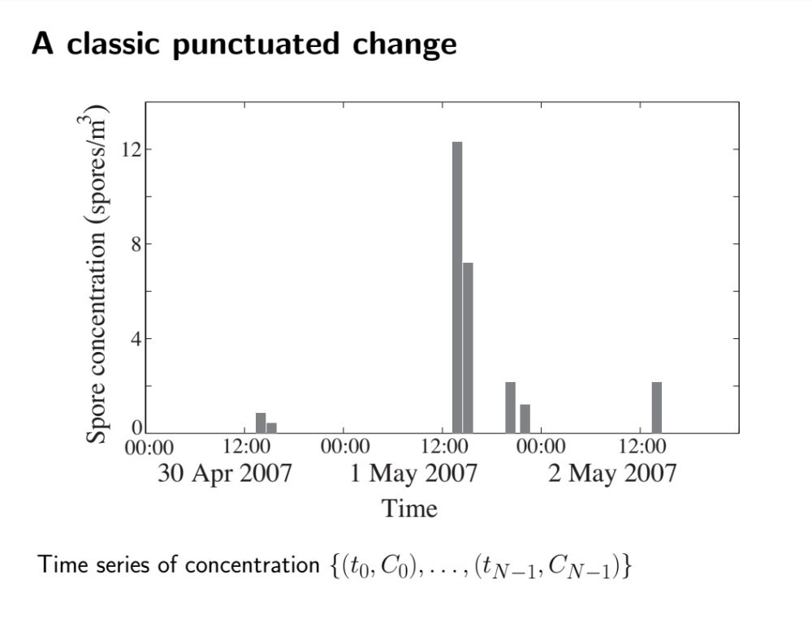

Slide 29
Define punctuated change as low probability events (assuming Poisson process), e.g., changes which have probability < 1%

Slide 30
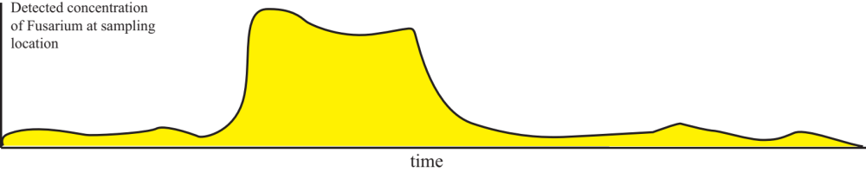
Punctuated changes:
How to understand cloud edges?
Coastal flow

Slide 31
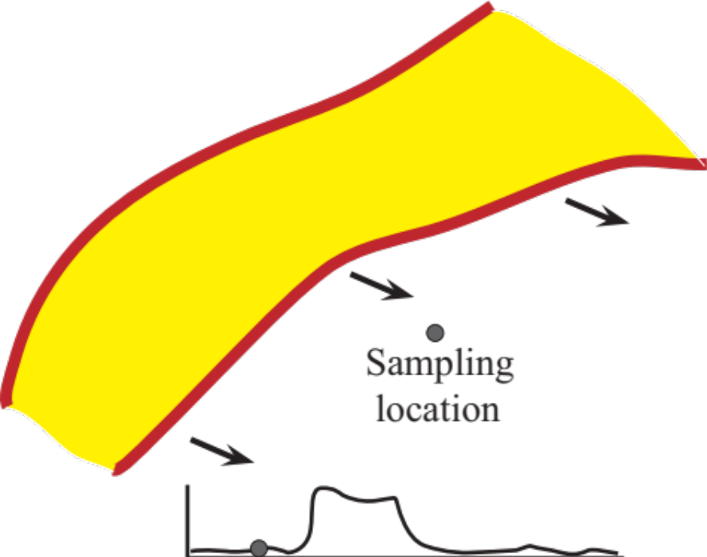
Punctuated changes:
How to understand cloud edges?
Coastal flow

Slide 32
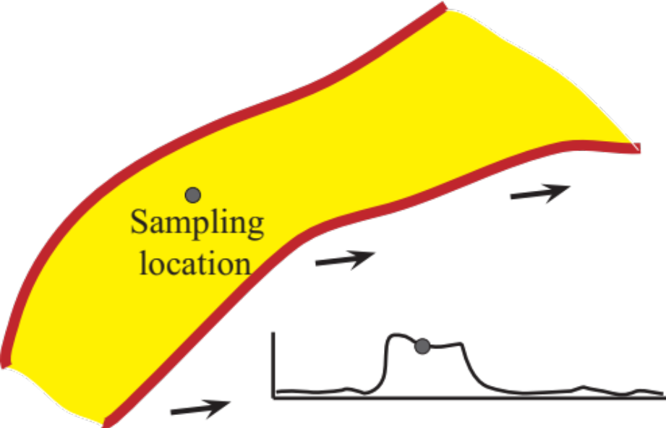
Punctuated changes:
How to understand cloud edges?
Coastal flow

Slide 33
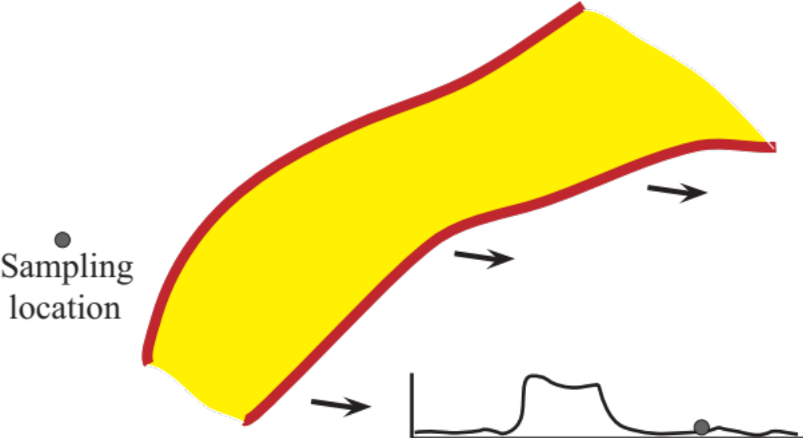
Punctuated changes:
How to understand cloud edges?
Coastal flow

Slide 34
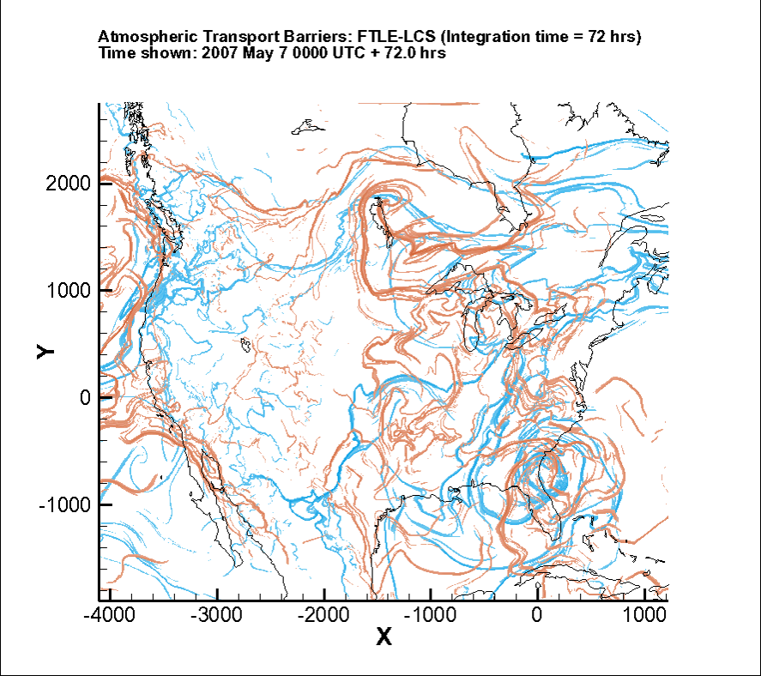
Atmospheric transport network
LCS, repelling (orange) and attracting (blue)
Atmospheric Superhighway,
a skeleton of large-scale horizontal transport
Relevant for large-scale spatiotemporal patterns
of pollution but also
biological agents
Coastal flow
orange = repelling LCSs, blue = attracting LCSs

Slide 35
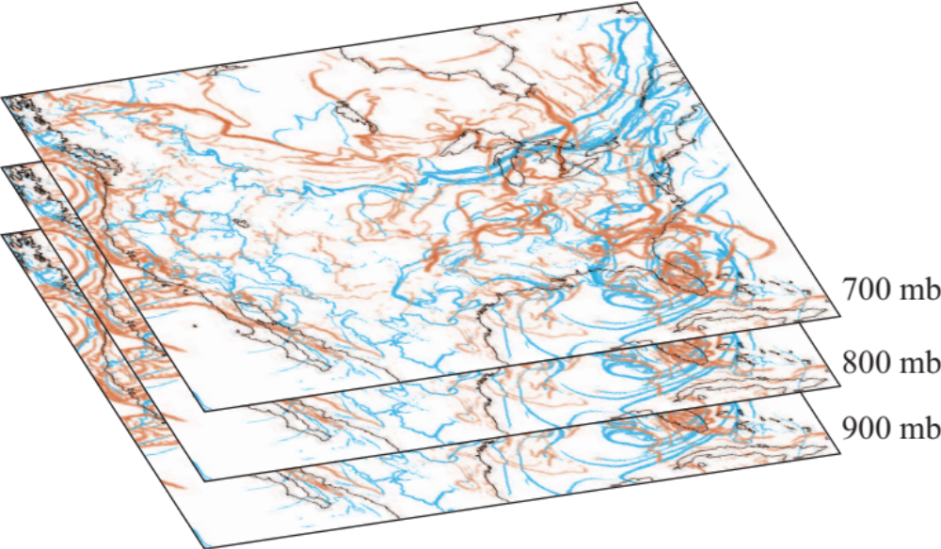
Mesoscale to synoptic scale motion
Consider first 2D motion, then fully 3D
Quasi-2D motion (isobaric) over timescales of interest, < 12-24 hrs, given by fungal spore viability
Using wind fields from
NOAA

Slide 36
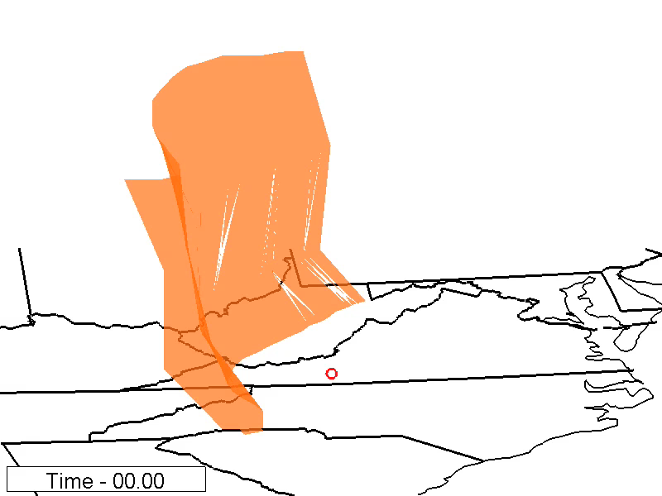
Curtain-like partitions moving over landscape

Slide 37
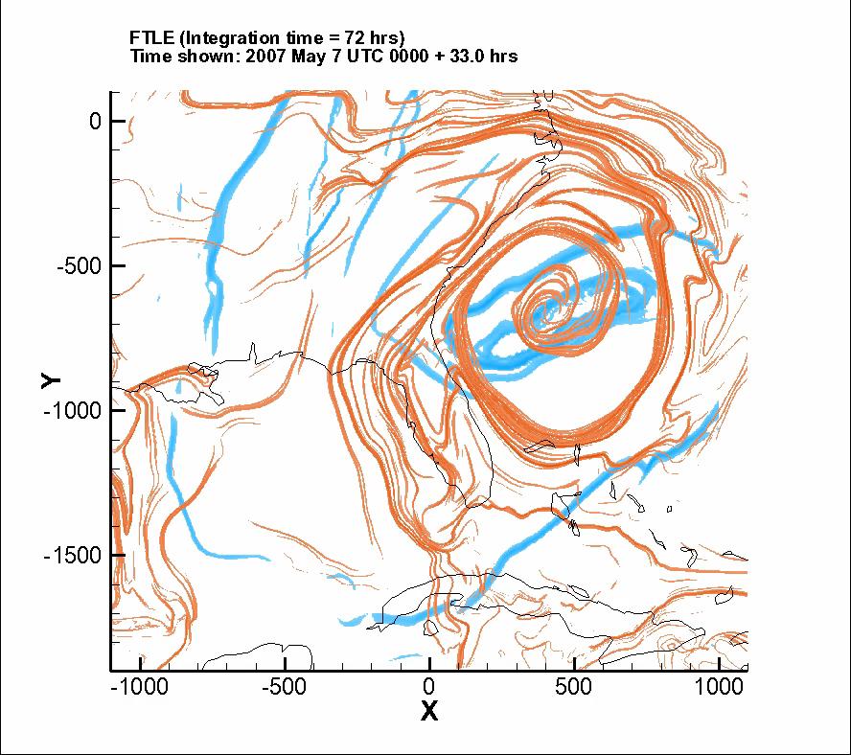
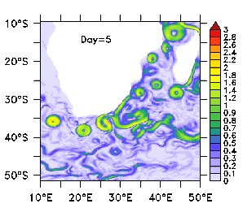
Identify coherent structures
Coherent atmospheric filaments or vortices mix little with surroundings, analogous to ocean eddies
Temporarily isolated sub-systems

Slide 38
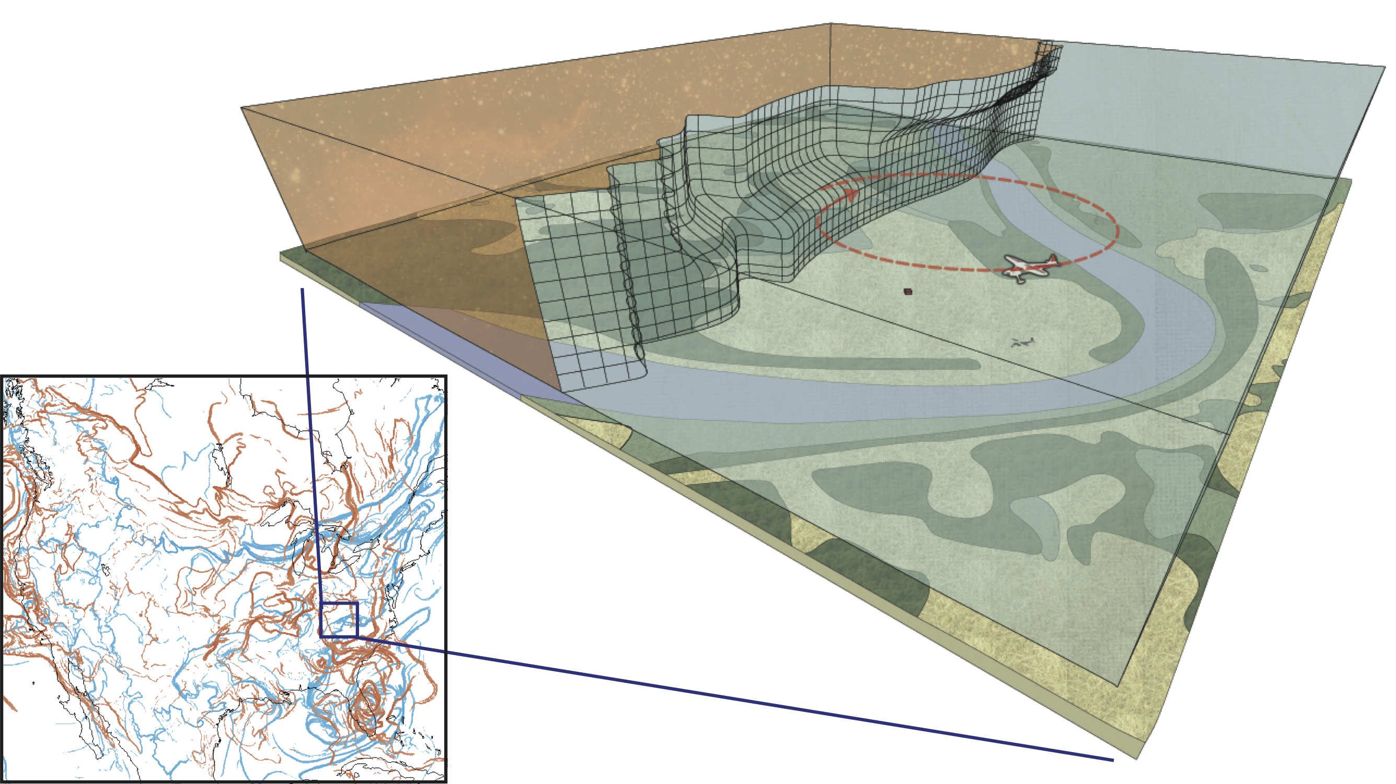
Volumes of differing spore composition
partitioned by LCS
Our unmanned aerial vehicles (UAVs) are usually sampling one side or the other
Notes:
Feedback loops

Slide 39
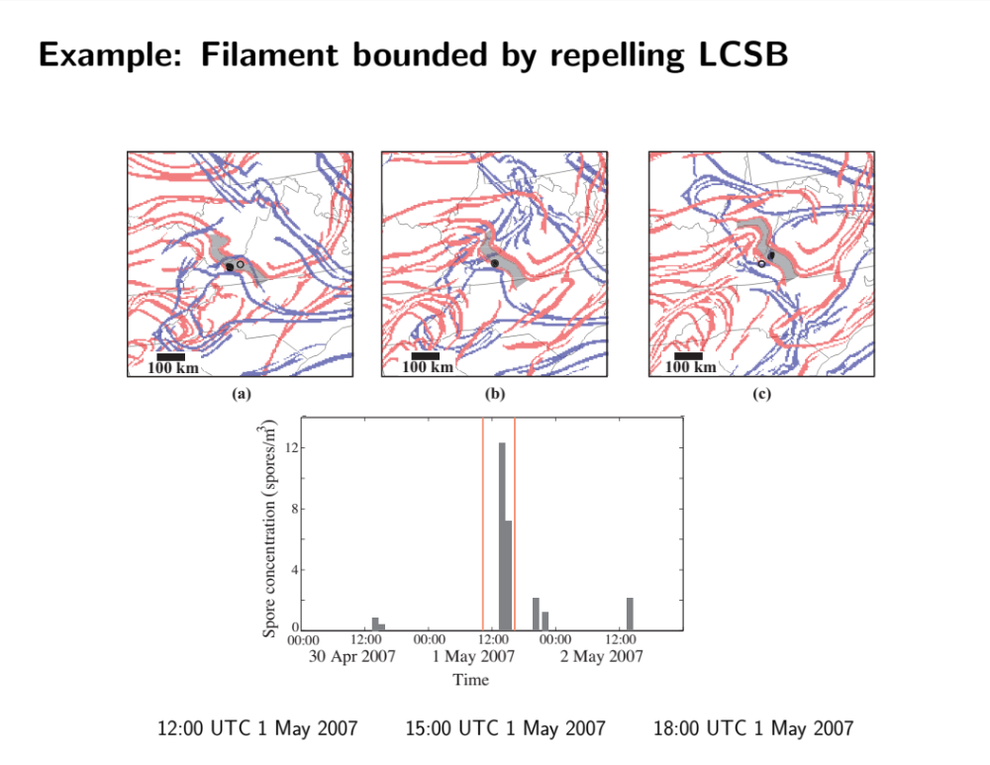
Filament with high pathogen values ‘sandwiched’ by LCS

Slide 40
Filament with high pathogen values ‘sandwiched’ by LCS
(a)
(b)
(c)

Slide 41
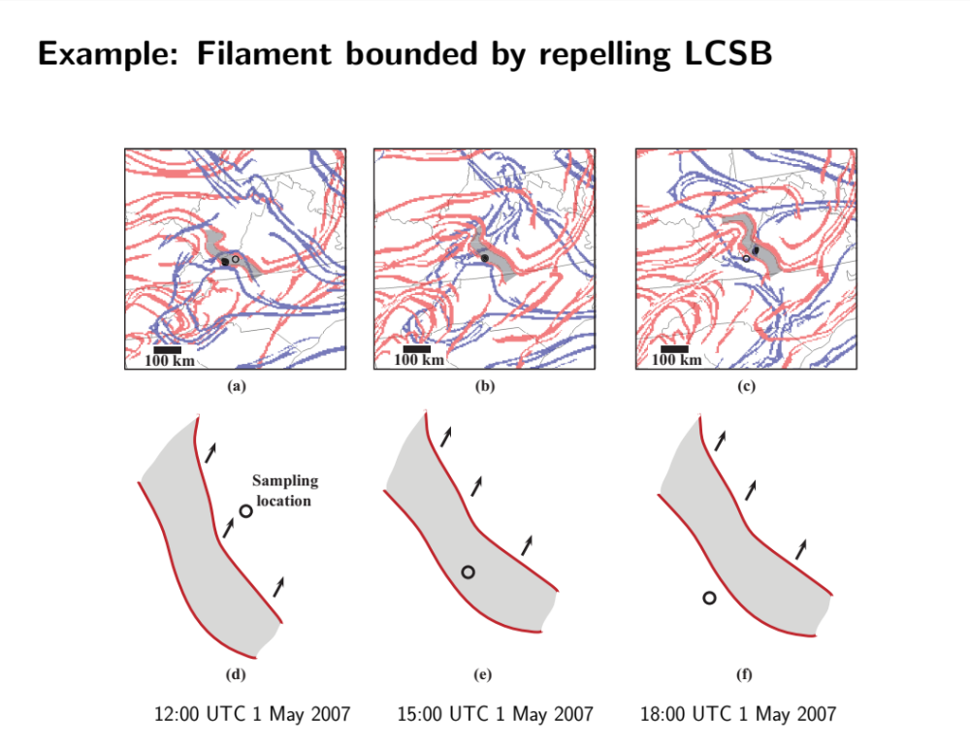
Filament with high pathogen values ‘sandwiched’ by LCS

Slide 42
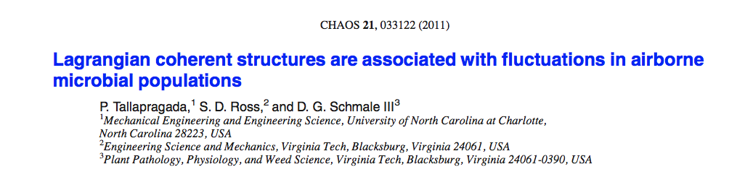
Punctuated change was associated with a LCS passage >70% of the time
Airborne biological agent concentrations can provide a proxy for measuring Lagrangian transport structure

Slide 43
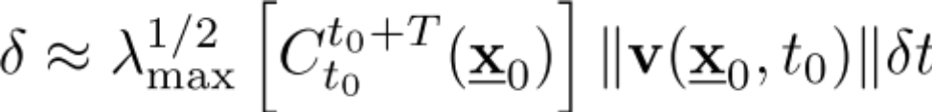
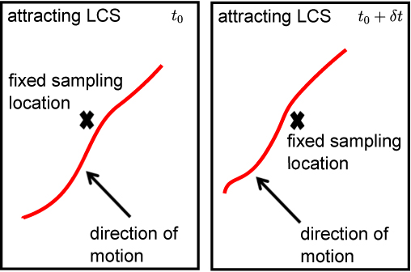
Sampling on either side of a LCS
If seeking geographically diverse samples, sample on other side of a passing LCS

Slide 44
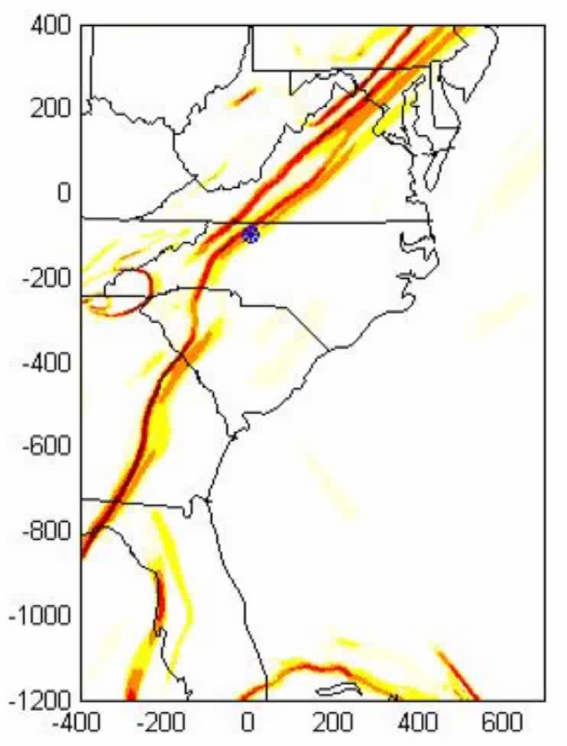
Sampling on either side of a LCS
Back trajectories with attracting LCS
Red: sample time: 1315 UTC
Blue: sample time: 1415 UTC
Red: sample time: 1315 UTC
Blue: sample time: 1415 UTC
Green: sample time 1515 UTC
Movie is showing time backwards
Back-trajectories shown

Slide 45
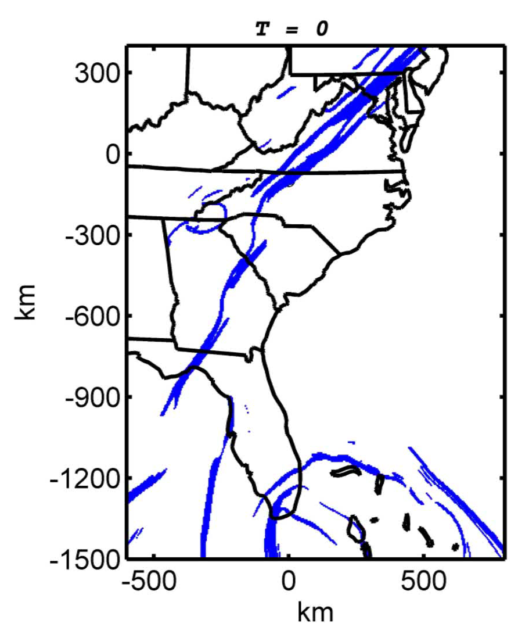
Sampling on either side of a LCS
Probabilistic source regions (considering sub-grid scale turbulence)
Sampling times:
1) 9:15 am (left cloud),
2) 10:15 am (right cloud),
Sept 29, 2010

Slide 46
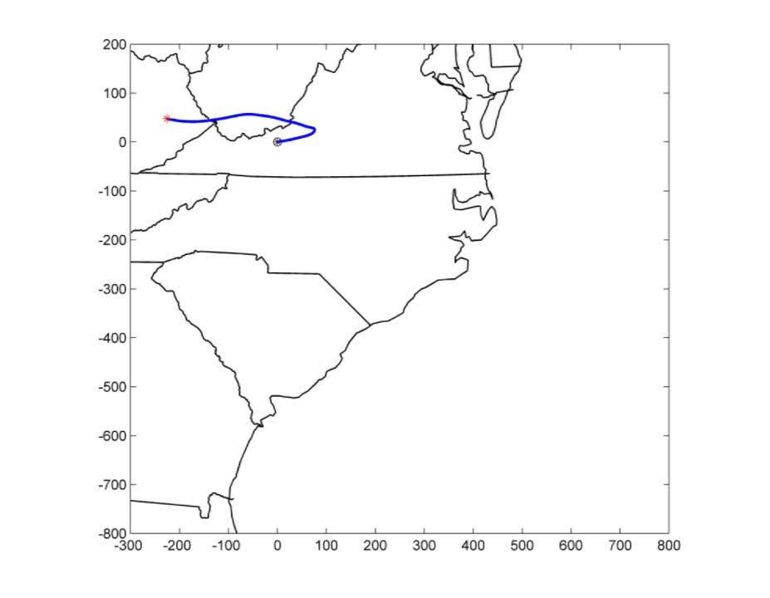
Sampling biological agents at a fixed location
Backward trajectory of particles, time delay = 1h
Sourceline of sampled points
made of initial points from
sequentially sampled pathlines
Strain along this curve related to FTLE
Sampling point: Virginia Tech campus
Sampling times: 8AM – 8AM, Sep 29 & 30, 2010
Integration time: - 24 h.

Slide 47
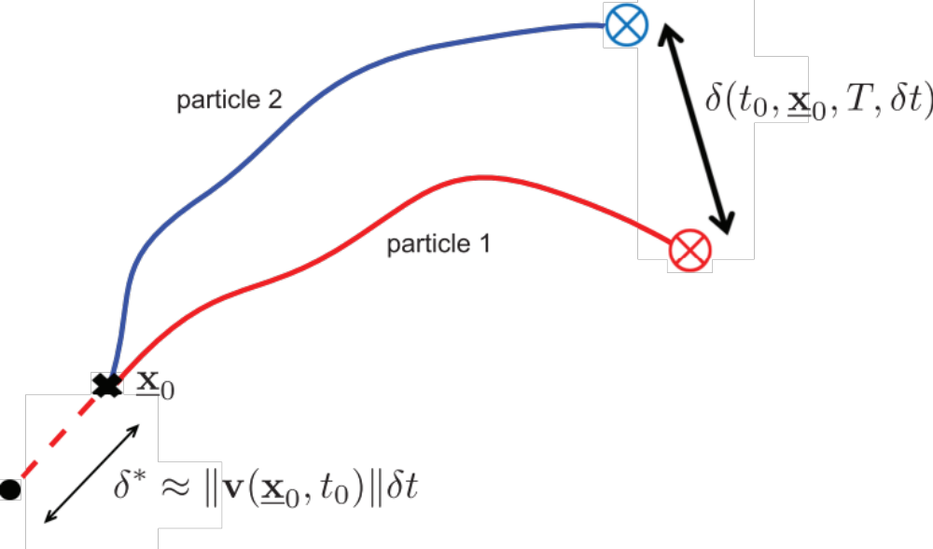
Sequential release (or capture) from a fixed location

Slide 48
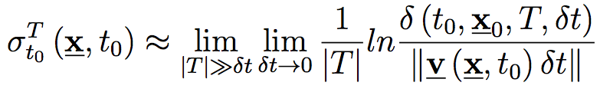
Sequential release (or capture) from a fixed location

Slide 49
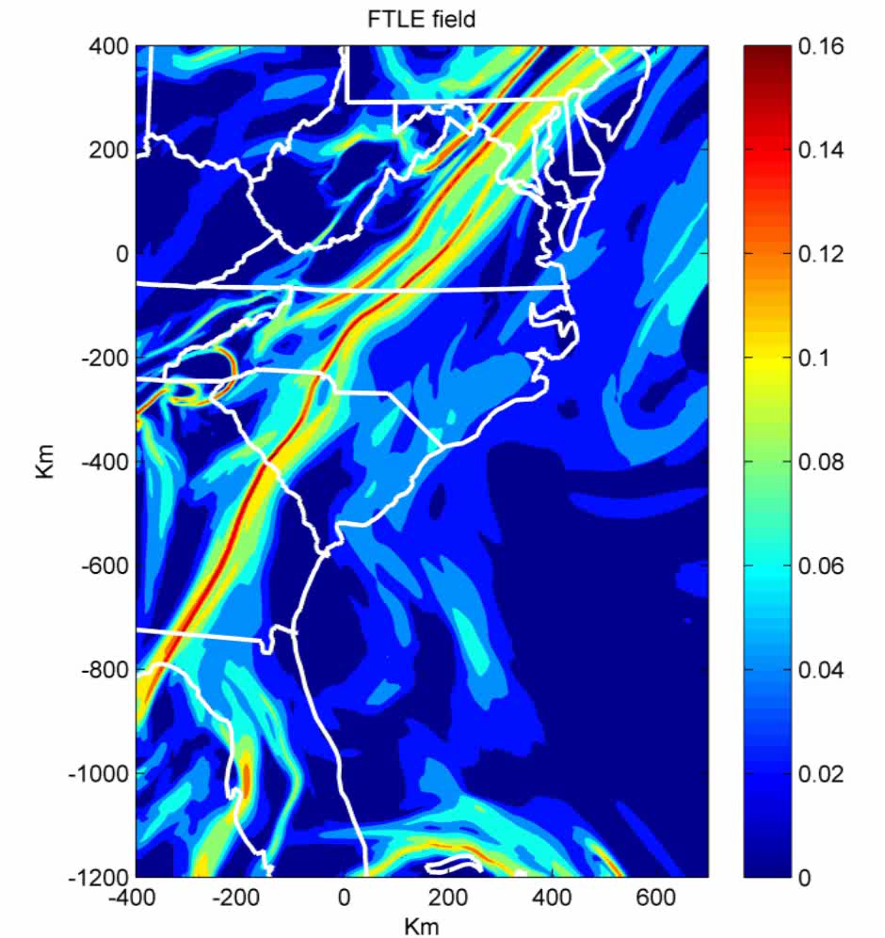
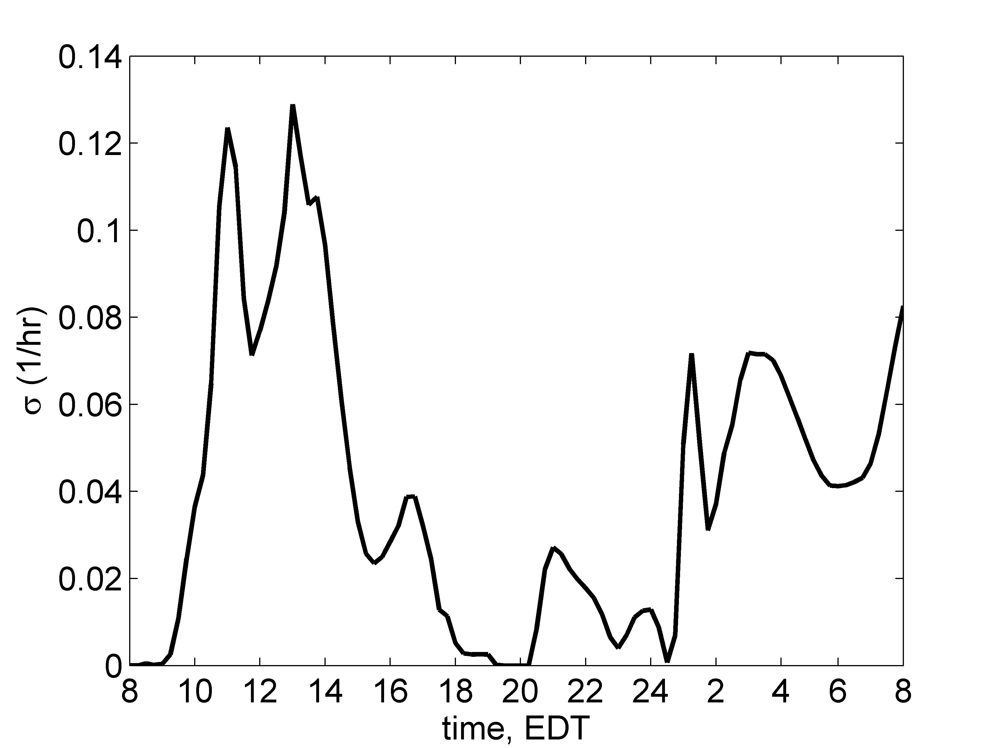
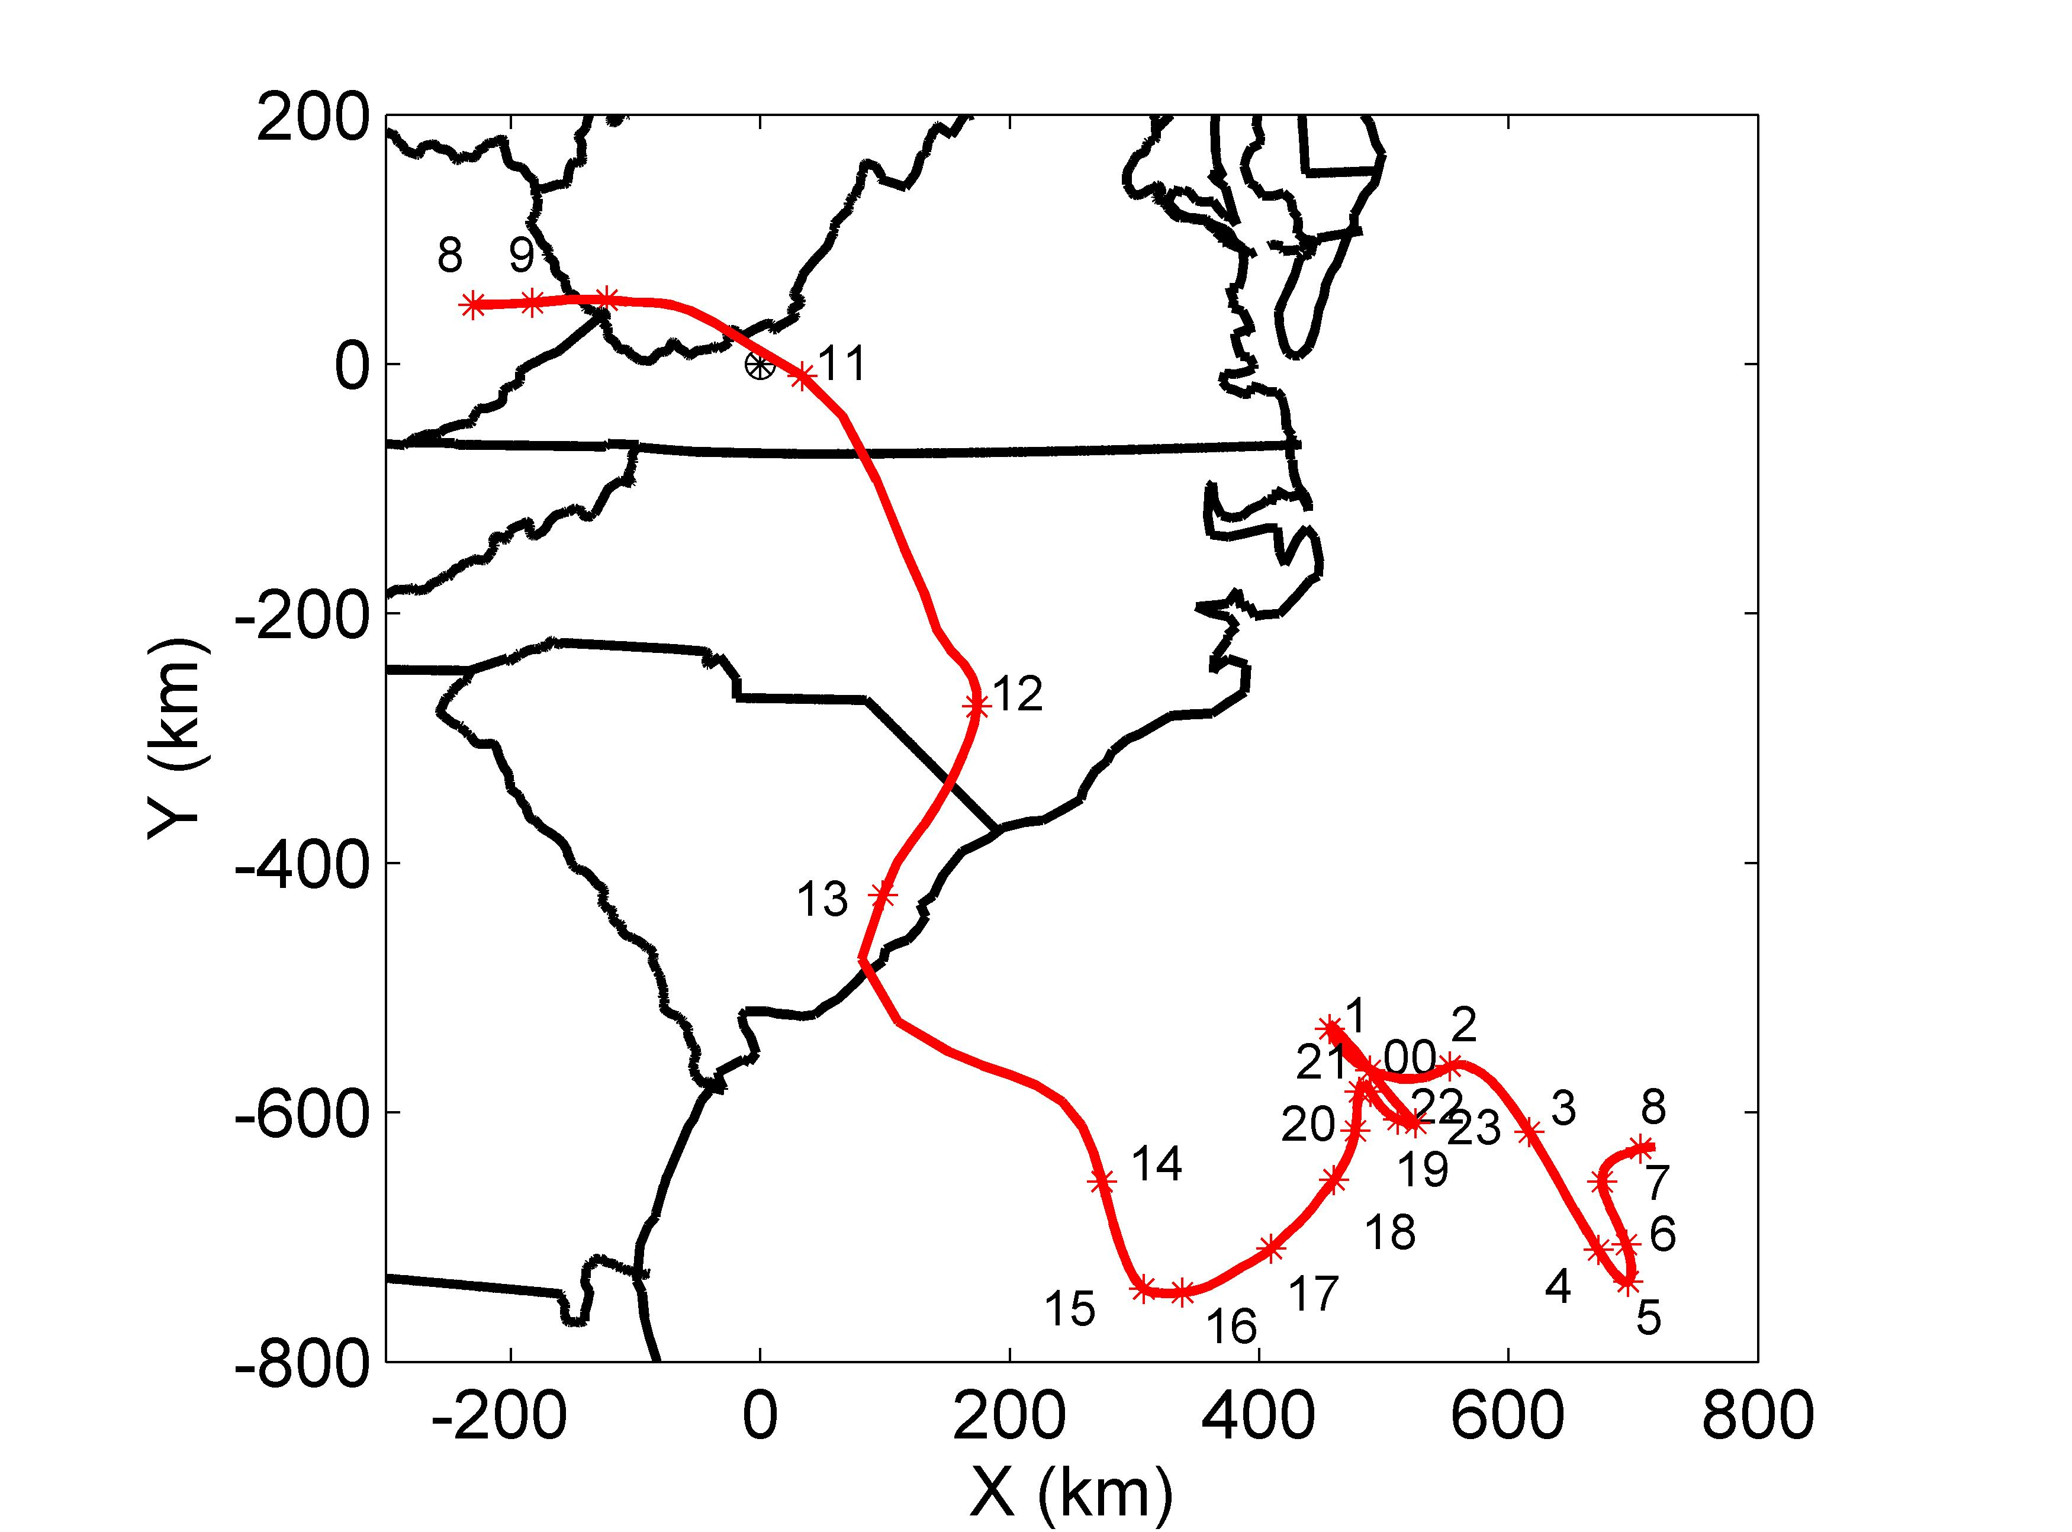

Sequential release (or capture) from a fixed location
FTLE time series at
one fixed location
Sourceline of sampled points
Distance between adjacent points along sourceline
FTLE for T = -24 hr
Distance between the initial position of the sampled particles

Slide 50

Forecasting atmospheric LCS
Wind field errors are not small or localized in time
BozorgMagham, Ross, Schmale [2013] Physica D

Slide 51

Forecasting atmospheric LCS
Using an ensemble forecasting approach
- Global scale (low res.) model
- ensemble of 15 members
Ensemble average
Standard deviation
BozorgMagham, Ross [2013]

Slide 52

Forecasting atmospheric LCS
Forecasting an LCS passage time
Can correctly forecast within 2 hours 60% of the time
BozorgMagham, Ross [2013]

Slide 53

Turbulence and source regions
Practical application: early warning systems
LCS or other transport analysis methods could help inform farmers regarding possible zones of disease spread

Slide 54

Likely dispersal pathways or persistent barriers
Turbulence and source regions

Slide 55



Aerobiology and the global transport of desert dust
NOAA simulation
Lagrangian
‘bridges’
connecting distant
ecosystems
Kellogg, Griffin [2006]

Slide 56


Final thoughts: coherence/transport in aerobiology
Could provide insight to spatiotemporal data and models
Future:
  3D
  Can LCS inform better management practices (e.g., fungicide spraying?)
  Map of global connectivity
  Effect of climate change
Notes:
Feedback loops

Slide 57


Sponsors: NSF DEB-0919088
NSF CMMI-1100263
Thank You

Slide 58
Extra Slides

Slide 59






Field experiments: tracking movement of plant pathogen from a controlled source
5 acres of winter wheat
Field inoculation
Inoculum preparation
Pathogen deposited decreases with distance
Dozens of samplers

Slide 60


Food supply concerns, bioterrorism

Slide 61

Microbes ride in clouds, catalyze rain

Slide 62

Auto-correlation vs. time-lag
Yields autocorrelation timescale of about 6 – 9 hours >> 10 min sample intervals
Can be interpreted as microbial ‘clouds’
with coherence scales of 20 - 100 km
Coastal flow

Slide 63

Future and ongoing work
Airborne collections may encode recent atmospheric mixing events
Consider geodesic theory to find KAM-like boundaries which can transport microbes
Notes:
Feedback loops

