Slide 1
Fall Risk Assessment

Slide 2
Introduction
21,700 fatal falls , 2.3 million nonfatal falls causes injuries in 2010
cost: 0.2 billion dollars fatal, $19 billion dollars nonfatal
different factors that assumed to have contribution in fall risk assesment
  Gait parameters
  fear of falling
  age
  diabetes
  visual measures
  location of COM
  location of COP

Slide 3
COP factor
The location of COP has fluctuation even in healthy young people
extracting information is difficult
Information in terms of unpredictability
Sample entropy measure of time series signal of location of COP
How similar the two vector of m sequential data are to each other
The similarity is defined by tolerance r
Sequence length m is called embedding dimension

Slide 4
Main goal
8 parameters in this study
  SaEn x-coordinate, Eyes closed, m =2, r=0.25
  SaEn y-coordinate, Eyes closed, m =2, r=0.25
  SaEn x-coordinate, Eyes closed, m =3, r=0.25
  SaEn y-coordinate, Eyes closed, m =3, r=0.25
  SaEn x-coordinate, Eyes open, m =2, r=0.25
  SaEn y-coordinate, Eyes open, m =2, r=0.25
  SaEn x-coordinate, Eyes open, m =3, r=0.25
  SaEn y-coordinate, Eyes open, m =3, r=0.25
Question: If these parameters have contribution in fall risk assessment, how we can use these parameters to predict the probability of fall?

Slide 5
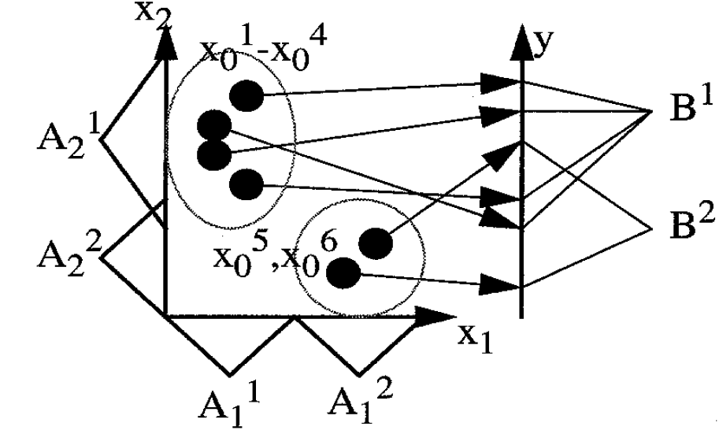
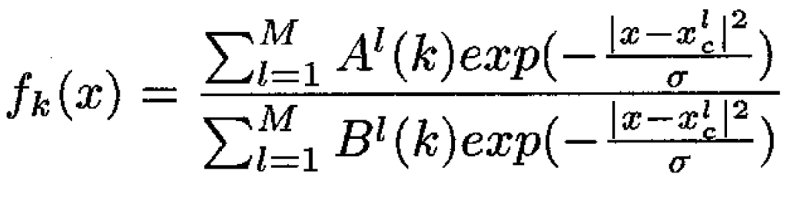
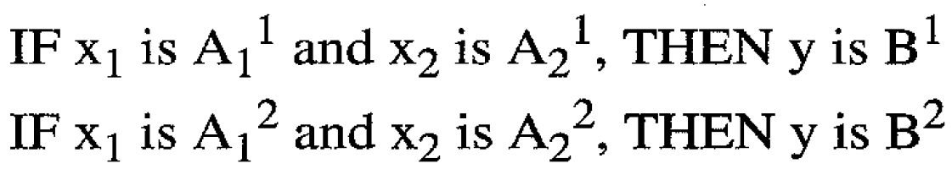
Fuzzy-clustering

Slide 6
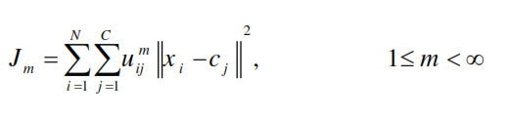
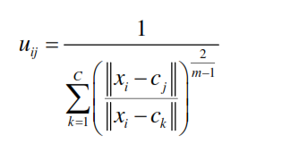
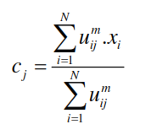

C-means method
This method allows one piece of data to belong to two or more clusters
This method is based on minimizing following objective function:
Using an iterative optimization algorithm on the objective function by updating the membership and the cluster centers , fuzzy partitioning is carried out as follows:
The iterations will continue until :
which k is the iteration step and ε is a termination criterion between 0 and 1

Slide 7
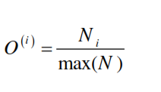
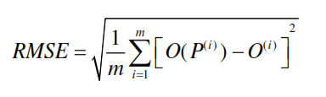
C-means method
the maximum number of falls for this group was 5 in the past 12 month, the following equation has been used to determine the membership function of each person:
First, each of the effective parameters has been considered independently, and then any possible combinations of these parameters (up to all 8 parameters) have been discussed.
The total number of different combination of parameters is 255.
85% of whole case study data has been used to train the fuzzy inference system and 15% of the data is used as the test data.
To evaluate the effectiveness of each combination of parameters, root mean square error (RMSE) has been used as follows:

Slide 8
Results
To simplify the problem, a new notation is introduced as follows:
- a number is assigned to each factor
- each combination of factors is presented by a row matrix ([ 1 0 0 1])
the RMSE for different combination of effective factors:
Factor Name | assigned Number
sample entropy_force plate_ center of pressure_eye open_X1 | 1
sample entropy_force plate_ center of pressure_ eye open _Y1 | 2
sample entropy_force plate_ center of pressure_ eye open _X2 | 3
sample entropy_force plate_ center of pressure_ eye open _Y2 | 4

Slide 9
Results
the algorithm has been repeated with number of clusters equal to 4, 6, 7 and 8:

Slide 10
Results
the closed eyes factors and the assigned numbers.
the RMSE for different combination of effective factors:
Factor Name | Assigned Number
sample entropy_force plate_ center of pressure_eye close_X1 | 1
sample entropy_force plate_ center of pressure_ eye close_Y1 | 2
sample entropy_force plate_ center of pressure_ eye close_X2 | 3
sample entropy_force plate_ center of pressure_ eye close_Y2 | 4

Slide 11
Results
the algorithm has been repeated with number of clusters equal to 4, 6, 7 and 8:

Slide 12
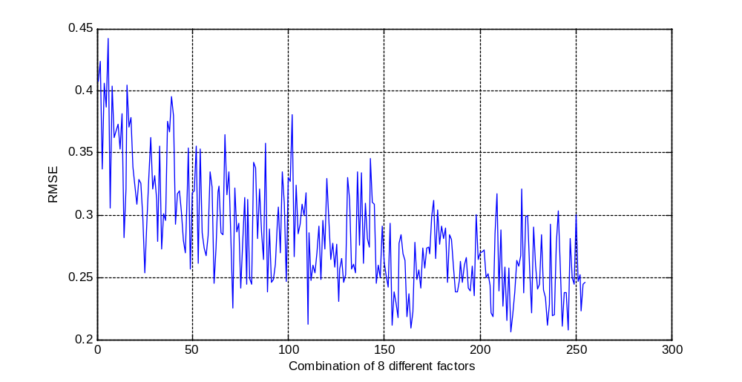
Results
All the factors and assigned numbers.
the RMSE for different combination of effective factors:
Factor Name | Associated Number
sample entropy_force plate_ center of pressure_eye open_X1 | 1
sample entropy_force plate_ center of pressure_ eye open _Y1 | 2
sample entropy_force plate_ center of pressure_ eye open _X2 | 3
sample entropy_force plate_ center of pressure_ eye open _Y2 | 4
sample entropy_force plate_ center of pressure_eye close_X1 | 5
sample entropy_force plate_ center of pressure_eye close_Y1 | 6
sample entropy_force plate_ center of pressure_eye close_X2 | 7
sample entropy_force plate_ center of pressure_eye close_Y2 | 8

Slide 13
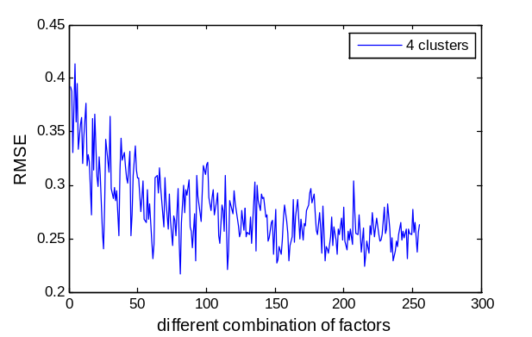
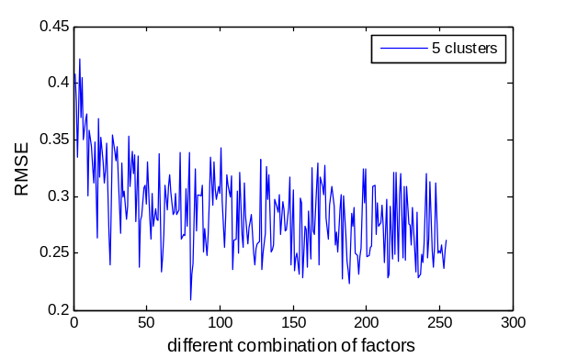
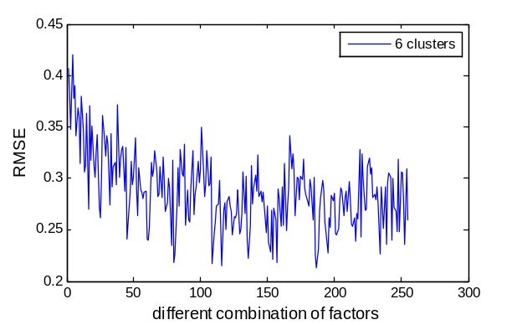
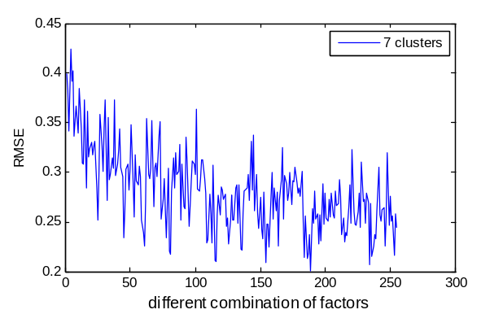
Results
For different number of clusters we have:

Slide 14
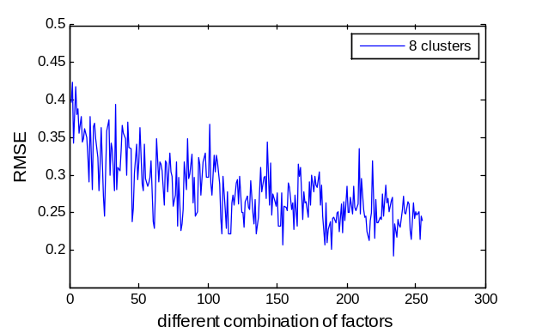
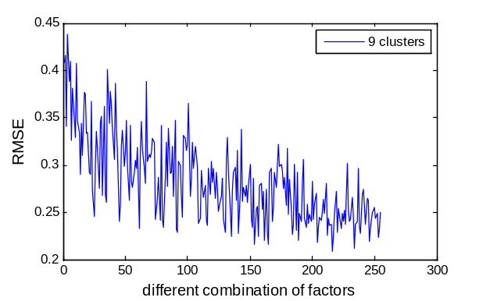
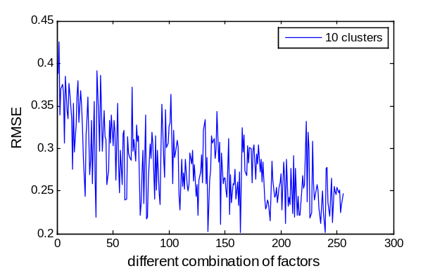

Results
Different number of clusters:

Slide 15
Conclusion
As the number of effective parameters increases, the RMSE decreases
The maximum RMSE was reported for the case that just one effective factors was considered
Number of clusters plays an important role in clustering problems, optimum number of clusters for 4 effective factors was revealed to be 5 and for 8 effective factors is 8.
The minimum RMSE error is 20% for the case that 7 of all 8 effective parameters are exist in the combination.

