Slide 1
Predicting Critical Transitions
Final Report
Keith Heyde

Slide 2
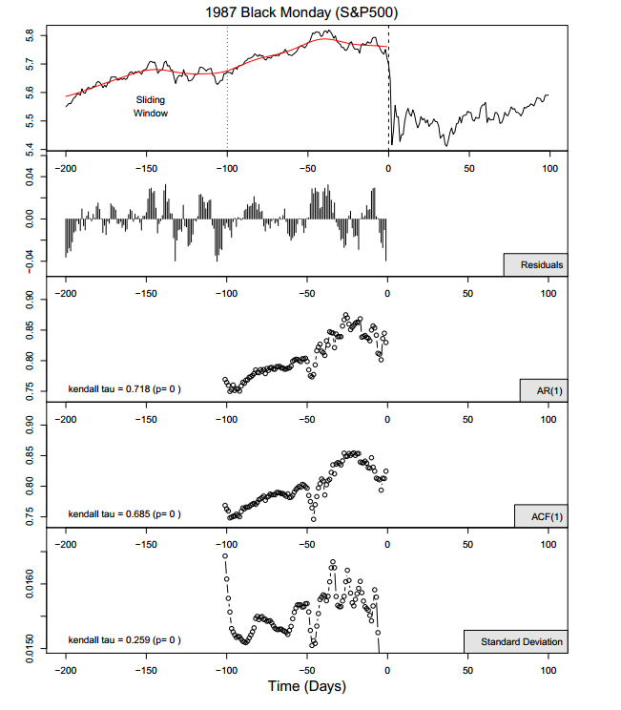
Diks et al. 2012

Slide 3
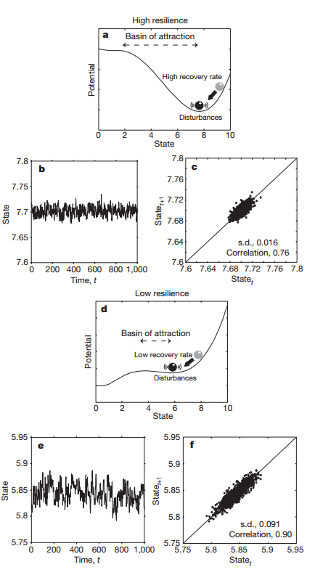
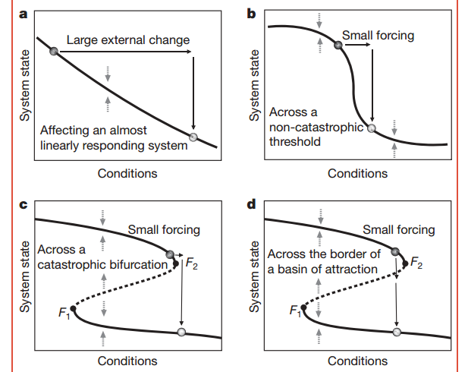
What Are Critical Transitions?

Slide 4
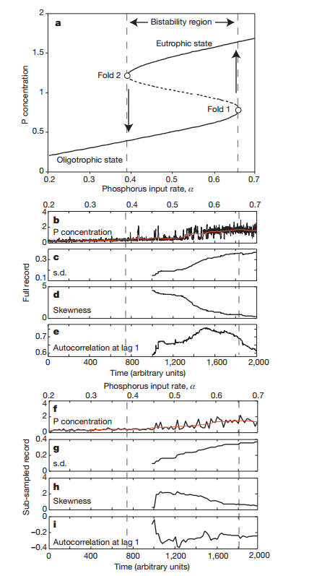

Predicting Critical Transitions: Case Study
Lake Eutrophication
Wang et al. 2012

Slide 5
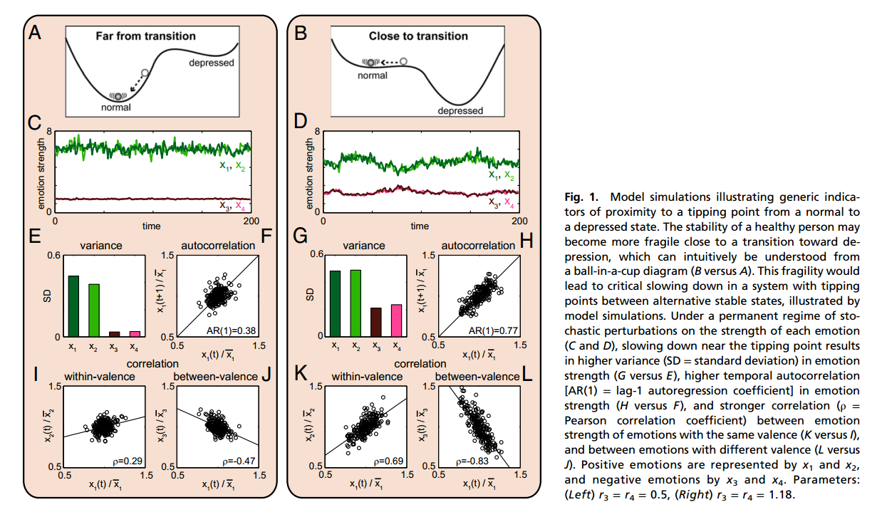
Previous Successful (Published) Examples
Stock Market (mixed results)
Climate – Flickering and critical slowing at Younger Dryas Cold Period
Ecosystems- Vegetation and Desertification
Agri/Aquaculture- Fishing stocks
Neurological- Epilepsy/ Depression
Leemput et al. 2013

Slide 6
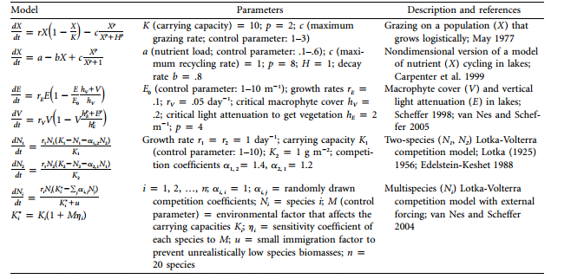
Toy Models- Population Based

Slide 7
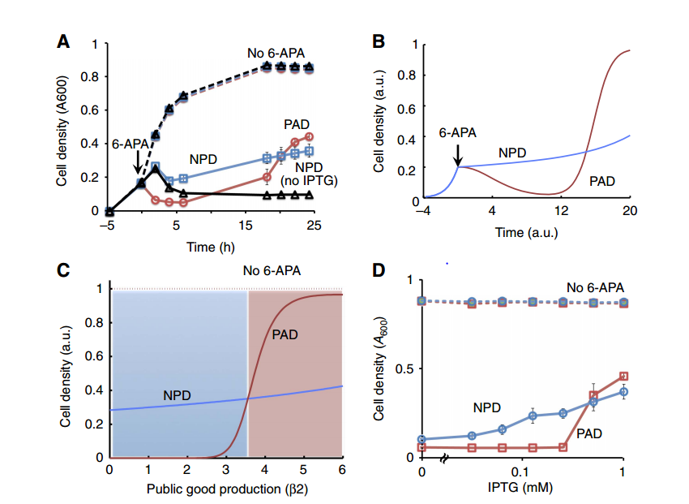
Population Data
Parameters: public good production (B2)
Multiple equilibria (including zero)
Sample data processing within MATLAB (autocorrelation and variance analysis)
MASSIVE FAILURE
Tanouchi et al. 2012

Slide 8

When the going gets tough…
The tough take on a new project!
And hit it out of the park?

Slide 9
Baseball Crash Course (for our purposes)
Players come up ‘to the plate’ during the game
Players try and ‘hit’ the ball
Players either get a ‘hit’ or get ‘out’
Players are commonly evaluated offensively by their batting average
Is this a good metric?

Slide 10
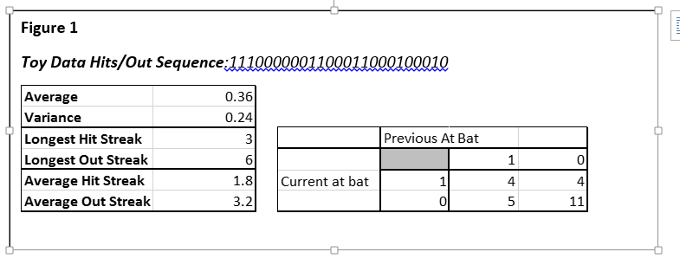
Baseball Streak Analysis
Classical

Slide 11
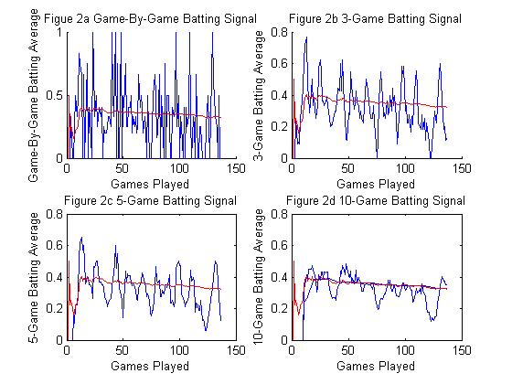
Turn Batting into a Signal!

Slide 12
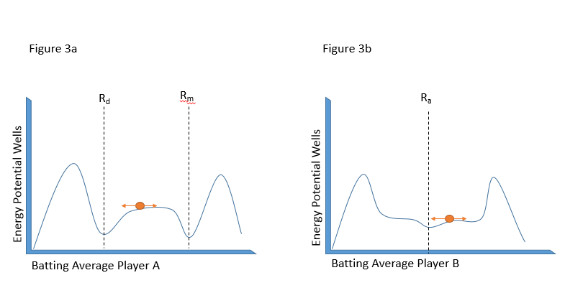
A Dynamical Systems Motivation
Batting
Batting
Games Played
Games Played

Slide 13
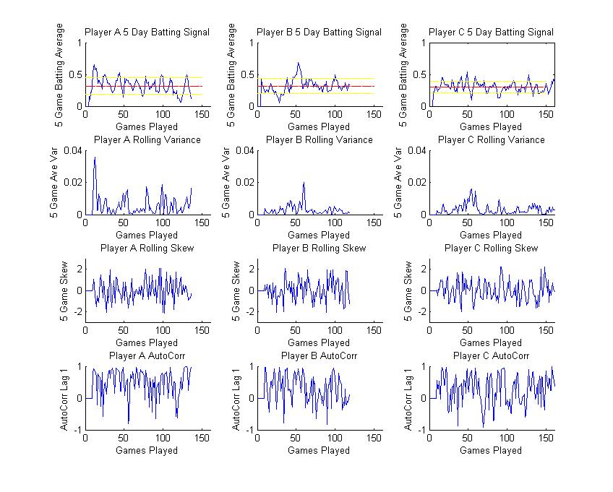
Real Player Data

Slide 14
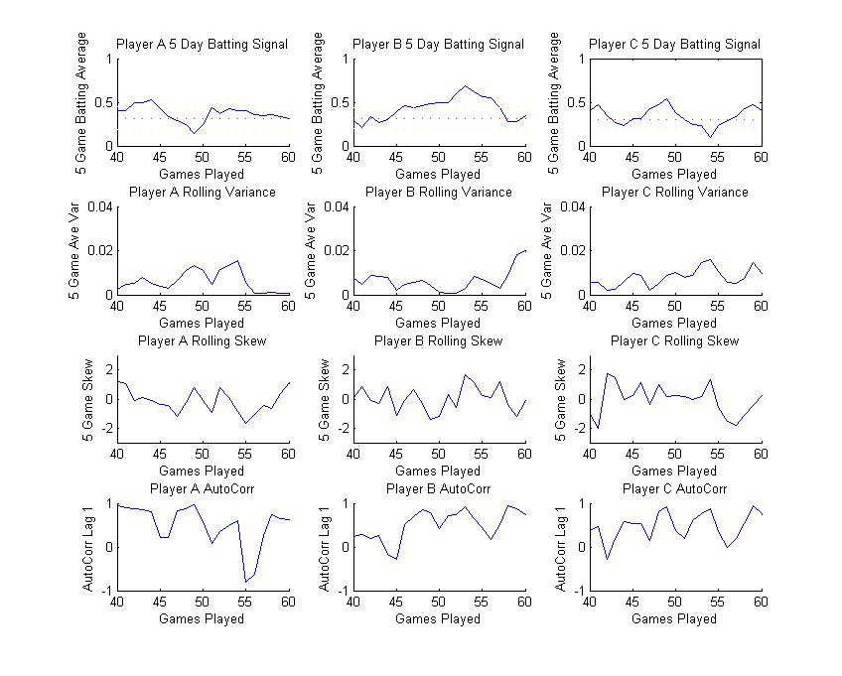
Zoom in!

Slide 15
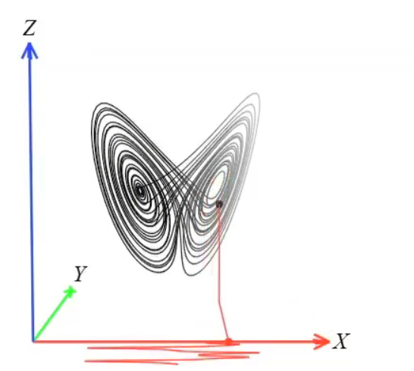
Underlying Structure?
Motivation:
Cool Videos Pay Attention
http://www.sciencemag.org/content/suppl/2012/09/19/science.1227079.DC1/1227079s1.mov
http://www.sciencemag.org/content/suppl/2012/09/19/science.1227079.DC1/1227079s2.mov
http://www.sciencemag.org/content/suppl/2012/09/19/science.1227079.DC1/1227079s3.mov
(Sugihara, 2012)

Slide 16
Underlying Structure?

Slide 17
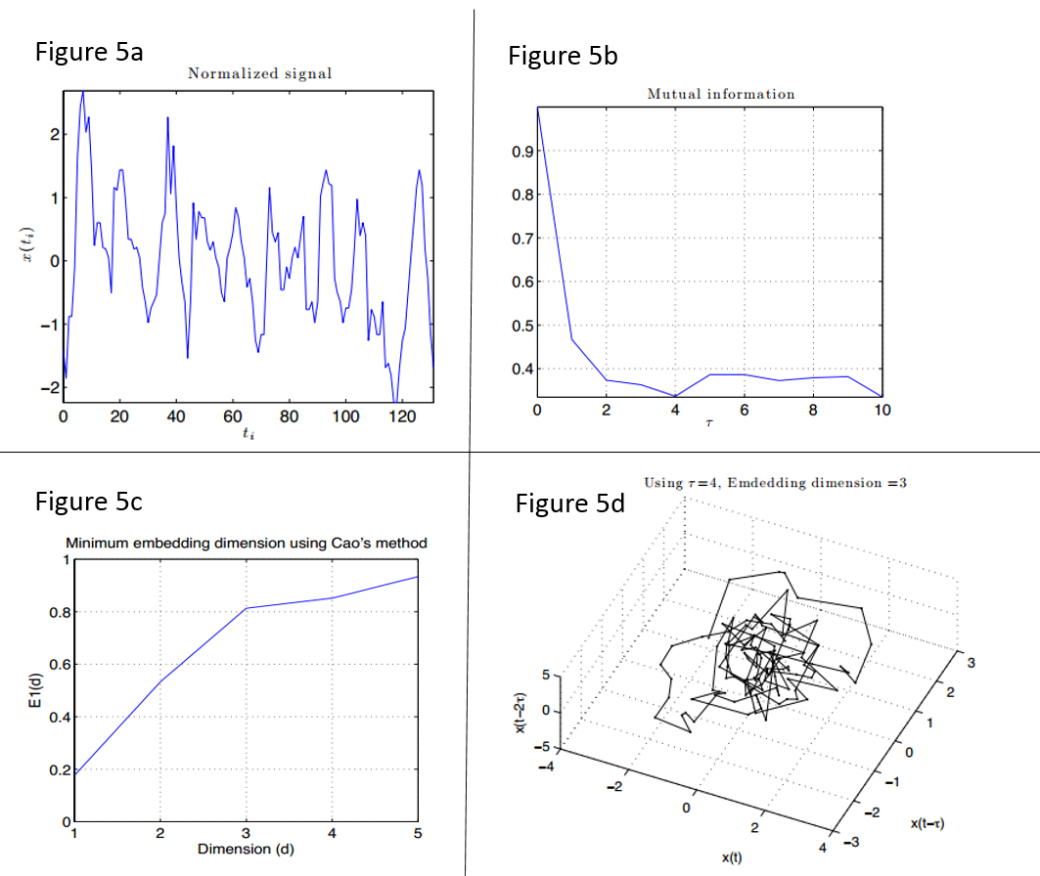
Analyzing Chaotic Signals Cont…

Slide 18
Conclusions and Next Steps
Conclusions
Early warning signs for bistable critical transitions do not seem to fit for baseball hitting signal
Multi-dimensionality of signal
Not enough granularity of data
Larger dimension structures do appear to exist
-> Even 2D structures seem to exist in time delay for many players
Next Steps
Preform a more comprehensive analysis on chaotic signals in baseball
Compare trends for dimensionality of streaky players vs non-streaky
See if there are any other metrics available to further refine phase space
Examine network dynamics of team to construct team dynamical system

Slide 19
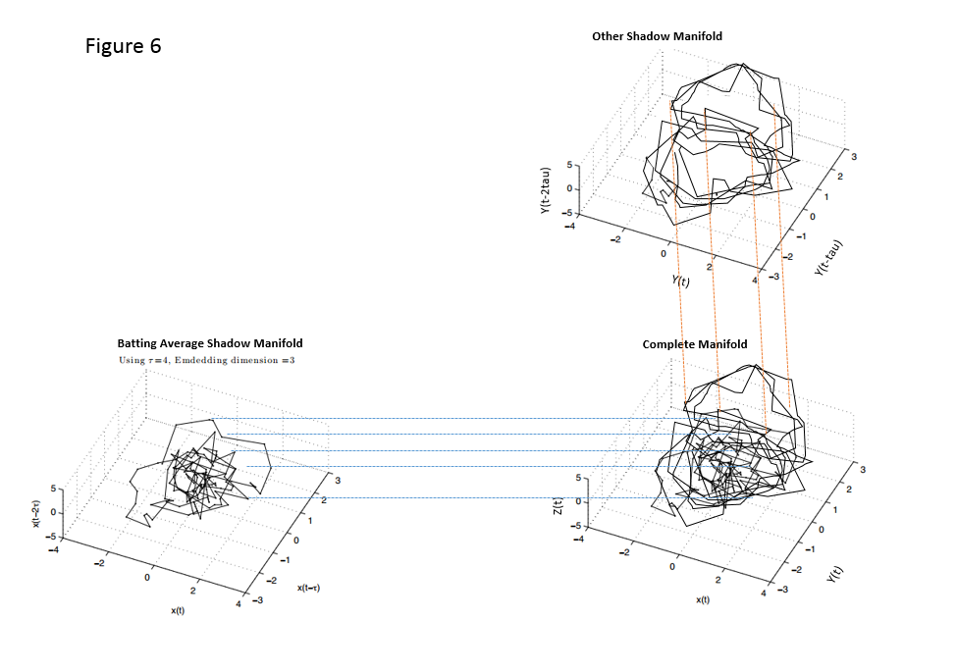
Potential Phase Space Reconstruction

Slide 20
Thanks!
Thanks to Prof. Ross and all of my reviewers

