Slide 1
Fall Risk Assessment
Masoud Shirazi
Seyedmeysam Khaleghian
Dr. Lockhart
Dr. Ross

Slide 2
Problem definition:
1 of 3 people 65+ fall every year¹
1 of 5 falls causes a serious injury²
Over 80% of all adverse events among hospital patients are associated with falls
⁻⁻⁻⁻⁻⁻⁻⁻⁻⁻⁻⁻⁻⁻⁻⁻⁻
1. Hornbrook, Gerontologist, 1994; Hausdorff, Arch Phys Med & Rehab, 2001
2. Sterling, J Trauma-Inj Infection & Critical Care, 2001

Slide 3
Background
Different parameters have been considered as effective parameters in the fall risk problem
---------------------
Granata K.P., Lockhart T.E., Dynamic stability differences in fall-prone and healthy adults, J Electromyogr Kinesiol (2007),
Lockhart, Thurmon E. and Liu, Jian(2008)'Differentiating fall-prone and healthy adults using local dynamic stability',Ergonomics,51:12,1860 — 1872
JJ. Collins, Open-loop and closed-loop control of posture: A random-walk analysis of center-of-pressure trajectories, Exp Brain Res (1993) 95:308-318
….
Height | Weight
Center of pressure | ABC score
Sit to walk time | Walk velocity
Gate cycle time | Double support time
Right/left stance time | Mean left/right swing time
Swing angle | Step length
Number of drink per week | Age

Slide 4
Parameter Normalization
Step Length / Height

Slide 5
Parameter Normalization
Double support time / gate cycle time

Slide 6
Parameter Normalization
Left Stance / Gate cycle time

Slide 7
Parameter Normalization
Right Stance / Gate cycle Time

Slide 8
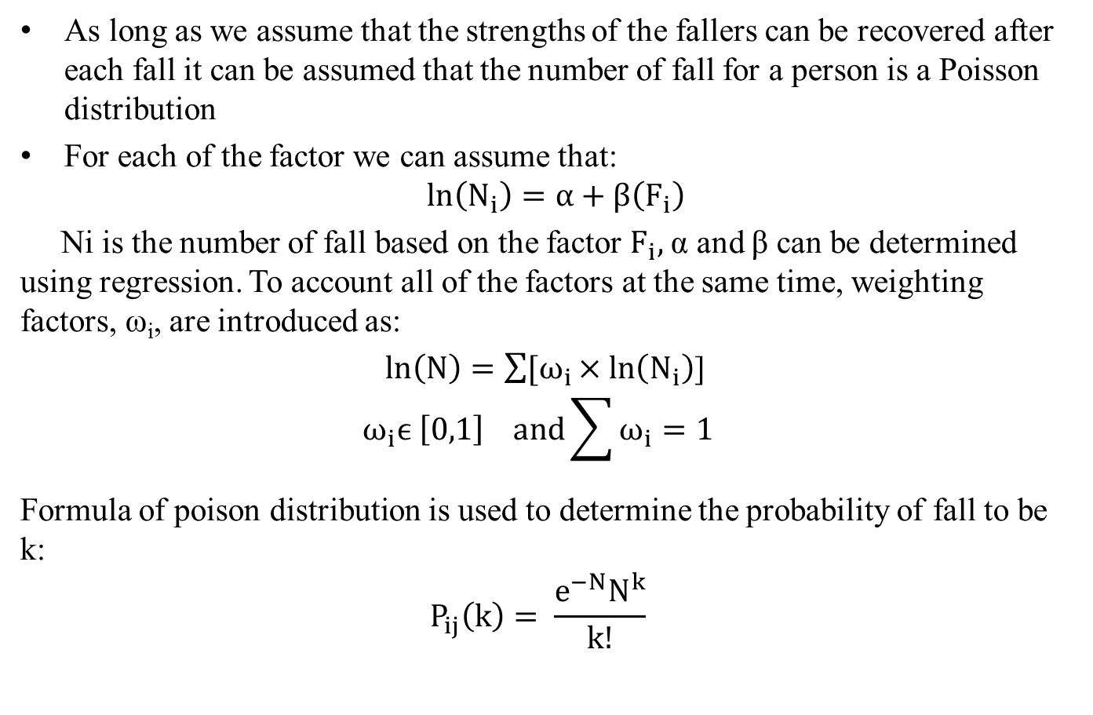
Theory

Slide 9
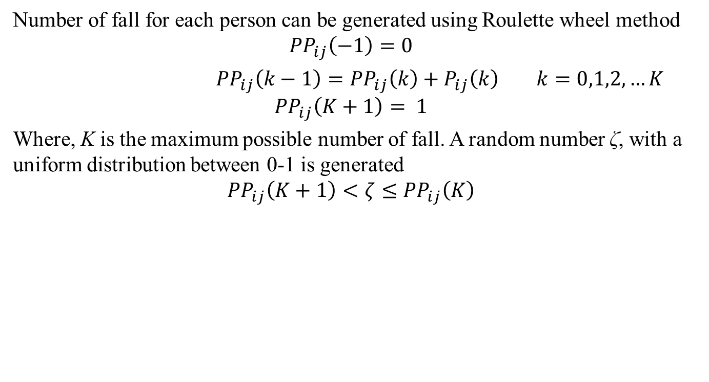
Theory

Slide 10
Theory
Human knowledge and experience is valuable but unfortunately not precise
  IF the speed of a car is high, THEN apply less force to the accelerator
The imprecise nature of human knowledge comes from the “Fuzzy” sets and statements
  What do you mean by “high speed”
Membership function “defuzzifies” the fuzzy sets by defining the “percentage” of belonging to a “fuzzy set”
  2 is 100% belongs to set of even numbers while 50 MPH is 80% high
Statements can be defuzzified by truth value
  “Fallers are over weighted” may be 80% right but “fallers wearing jackets” may be 5% right
A “rule” can also be true to some degree
  “IF the speed of a car is high, THEN apply less force to the accelerator” is 80% true in rural streets but 15% true or appropriate in a race
Try to act or predict based on the truth of rules. Only act upon what “makes sense”
The “action” /“decision” can also be taken/made to some degree

Slide 11
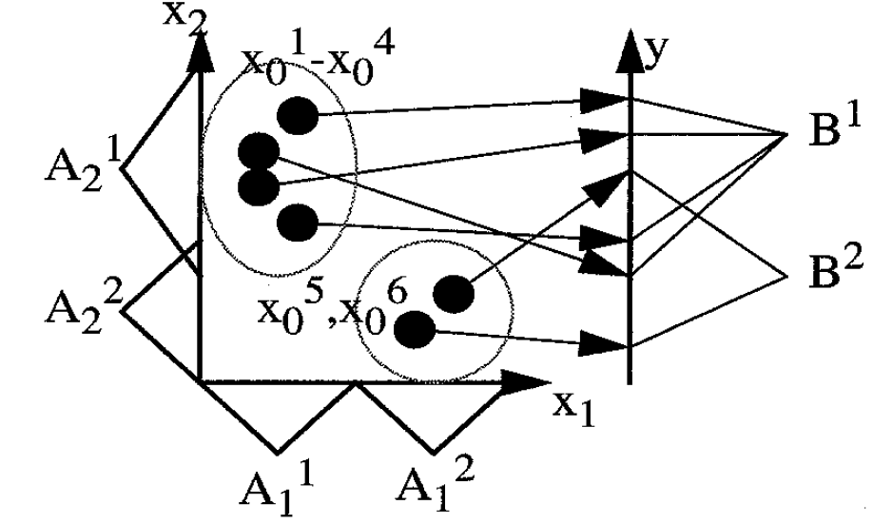
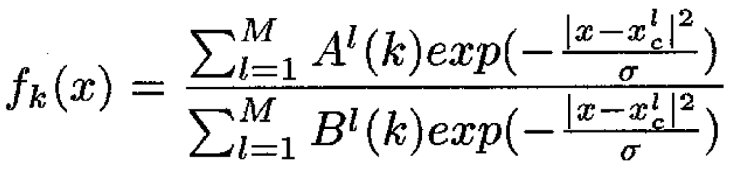
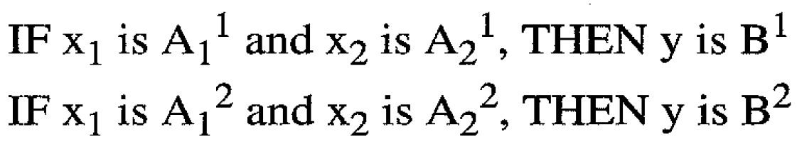
Theory

Slide 12
Thanks

