Slide 1
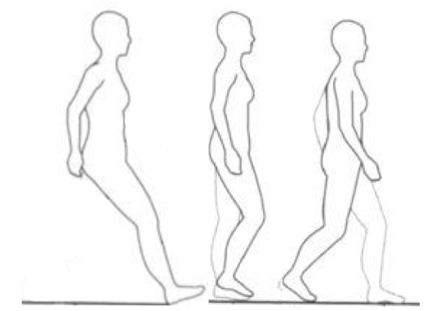
Fall Risk Assessment: Postural Stability and Non-linear Measures
ESM 6984: Frontiers in Dynamical Systems
Mid-term presentation
Sponsor: Dr. Lockhart
Team Members:
Khaled Adjerid, Peter Fino, Mohammad Habibi, Ahmad Rezaei

Slide 2

Fall risk assessment
The injuries due to fall and slip pose serious problems to human life.
Risk worsens with age
Hip fractures and slips
15,400 American deaths
$43.8 billion annually

Slide 3
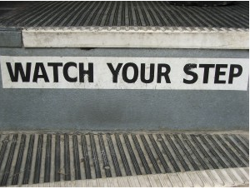
Technical approach
How can we assess fall risk in the elderly?
Walking and balance is complex
Multiple mechanisms involved in slip and fall
Studies focused on age-related studies
No significant approach has been proposed to predict the fall risk accurately.

Slide 4

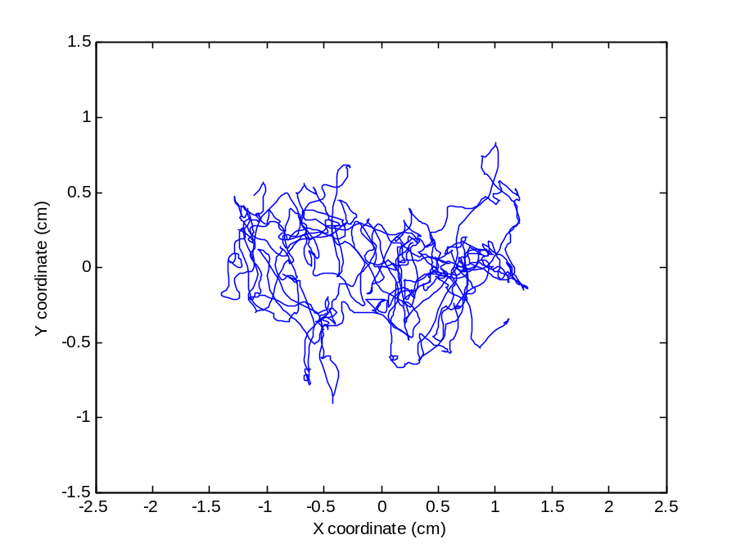
What data do we actually have?
60 second postural stability COP data
  Eyes open
  Eyes closed
10 m walking
Sit to stand
Timed up & go
X
a_{x}
α
A
a_{y}
a_{z}
β
γ
D
dx
dz
Y
Z
Projected Path
dy

Slide 5
Time Series Analysis
Several methods have been developed for complexity, correlation and recurrence measures in time series:
Shannon entropy (shen)
Renyi entropy (ren)
Approximate entropy (apen)
Sample entropy (saen)
Multiscale entropy (MSE)
Composite multiscale entropy (CMSE)
Recurrence quantification analysis (RQA)
Detrended fluctuation analysis (DFA)

Slide 6
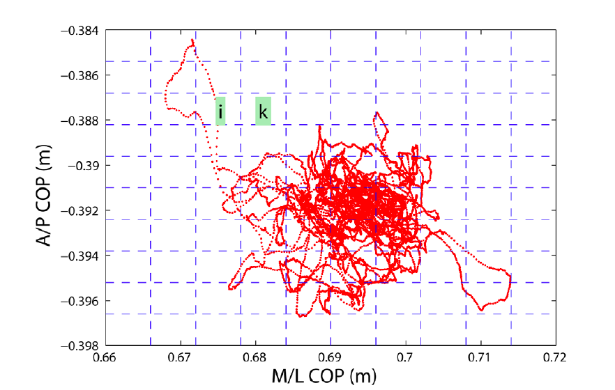




Renyi and Shannon entropies will be calculated for COP measurements
Measure of uncertainty in the system over time
Gao M. et al, 2011
Split COP X-Y field into unit areas
COP Trajectory is points long
Each unit area is visited times

Slide 7
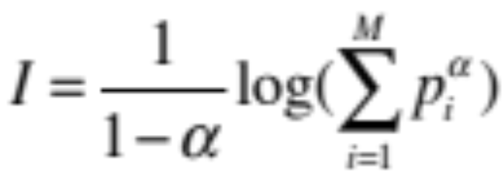
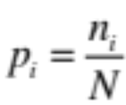
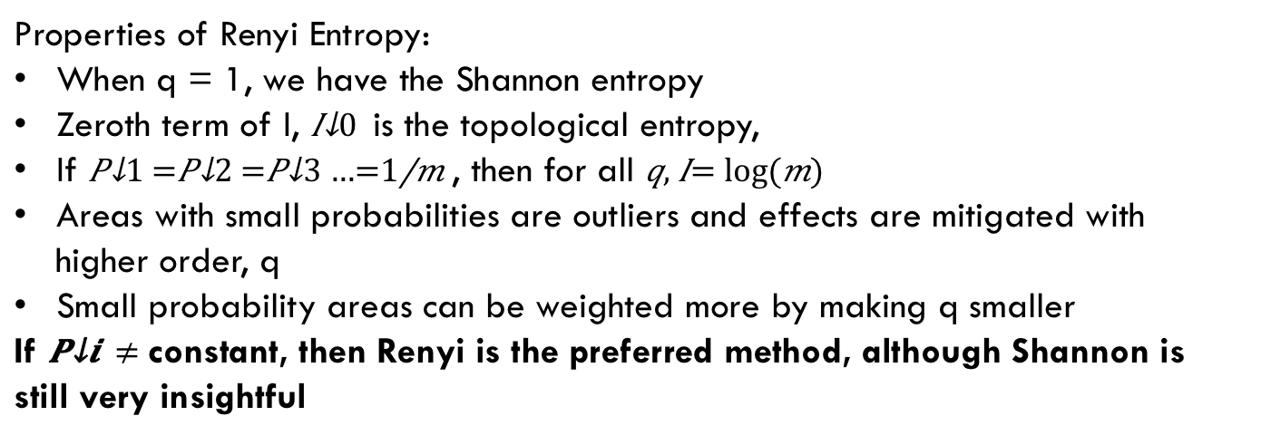

Renyi and Shannon entropies will be calculated for COP measurements
Renyi Entropy:
Where probability of trajectory falling in $M_{i}$ is defined as
Generalized form of entropy of order α
Properties of Renyi Entropy:
When q = 1, we have the Shannon entropy
Zeroth term of I, $I_{0}$is the topological entropy,
If $P_{1}=P_{2}=P_{3}…=\frac{1}{m}$, then for all $q, I= log⁡(m)$
Areas with small probabilities are outliers and effects are mitigated with higher order, q
Small probability areas can be weighted more by making q smaller
If $P_{i} ≠$constant, then Renyi is the preferred method, although Shannon is still very insightful
α=1
α
α
α smaller
Notes:
Entropy: uncertainty or randomness of a variable, shannon: quantifying expected value of information in a trace/message or average unpredictability in a random variable, aka the information content

Slide 8
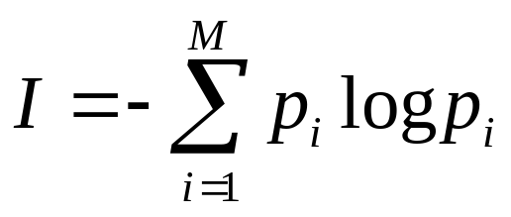
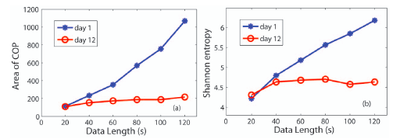
Renyi Entropy is a generalized form of Shannon entropy
Shannon Entropy:
(Base e)
When order of Renyi entropy $q = 1$, we have the Shannon entropy
Gao M. et al, 2011

Slide 9

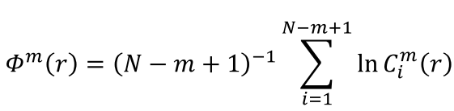




Approximate Entropy (ApEn)¹
m: length of sequences to be compared
r: tolerance (filter) for matching sequences
N: length of time series
Where;
and
1- Steven M. Pincus, Approximate entropy as a measure of system complexity, Proc. Nati. Acad. Sci. USA Vol. 88, pp. 2297-2301, 1991.

Slide 10
Approximate Entropy (ApEn)
Example for r=0, m=2, N=6
u={4, 6, 3, 4, 6, 1}
x²_{i}={(4, 6), (6, 3), (3, 4), (4, 6), (6, 1)}
x³_{i}={(4, 6, 3), (6, 3, 4), (3, 4, 6), (4, 6, 1)}
Step 1:
find the number of matches between the first sequence of m data points and all sequences of m data points.
No of matches: 2
Step 2:
find the number of matches between the first sequence of m+1 data points and all sequences of m+1 data points.
No of matches: 1
Step 3:
divide the results of step 4 by the results of step 3, and then take the logarithm of that ratio: 1/2
Step 4: Repeat step 1-3 for the remaining data points and add together all the logarithms computed in step 3 and divide the sum by (m-N).

Slide 11

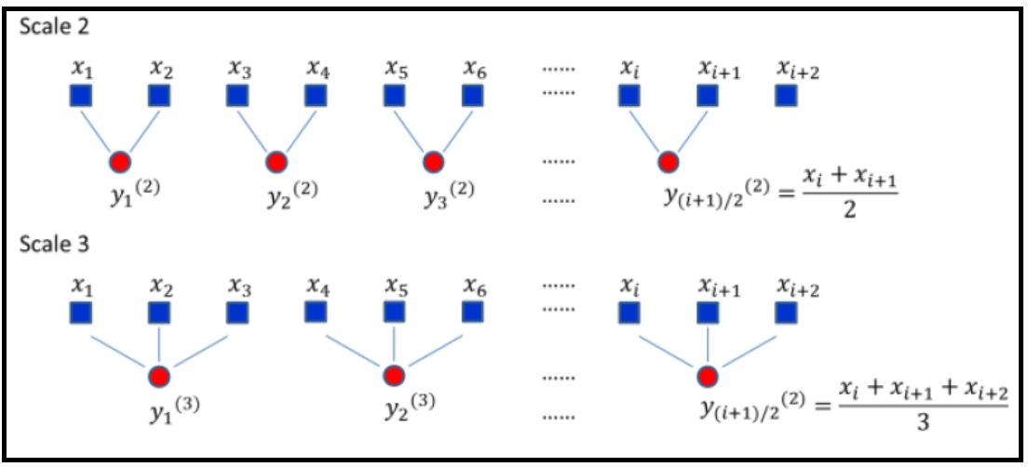
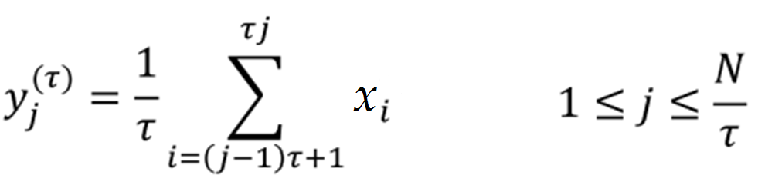
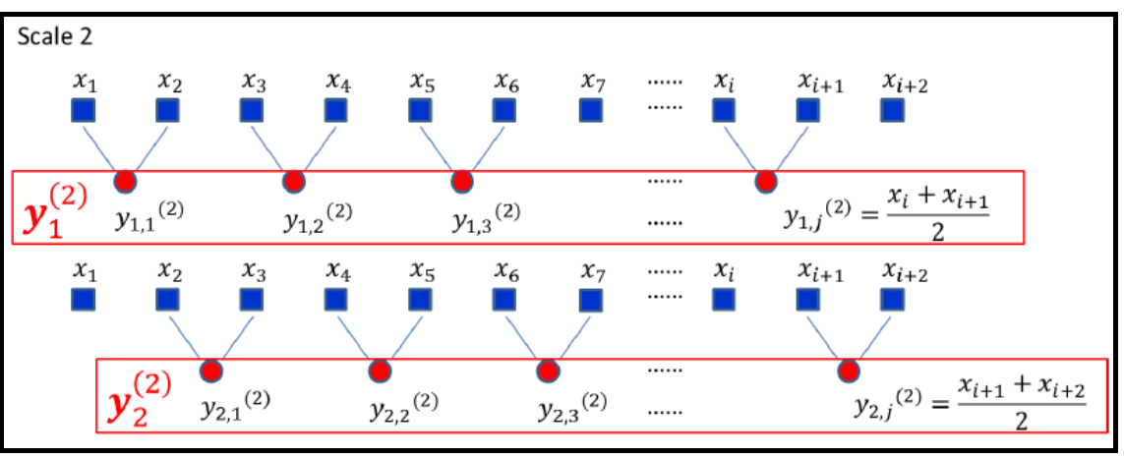
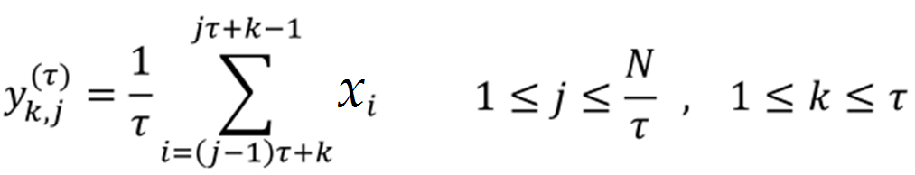
SaEn, MSE and CMSE
Sample entropy (SaEn): no self-matching so no bias in calculation of SaEn:
Multiscale entropy (MSE):
Computing SaEn of y_{j} for different scale factors:
Composite multiscale entropy (CMSE):
Computing SaEn of y_{k,j} and take average
for k from 1 to τ for different scale factors:
Figures adapted from: Shuen-De Wu et. al. , Time Series Analysis Using Composite Multiscale Entropy, Entropy, Vol. 15, pp. 1069-1084, 2013.

Slide 12

Recurrent Quantification Analysis (RQA)
Animation created by:
André Sitz (AS-Internetdienst Potsdam) and Norbert Marwan (Potsdam Institute for Climate Impact Research (PIK))
(www.recurrence-plot.tk)
N. Marwan, M. C. Romano, M. Thiel, J. Kurths: Recurrence Plots for the Analysis of Complex Systems, Physics Reports, 438(5-6), 237-329, 2007

Slide 13
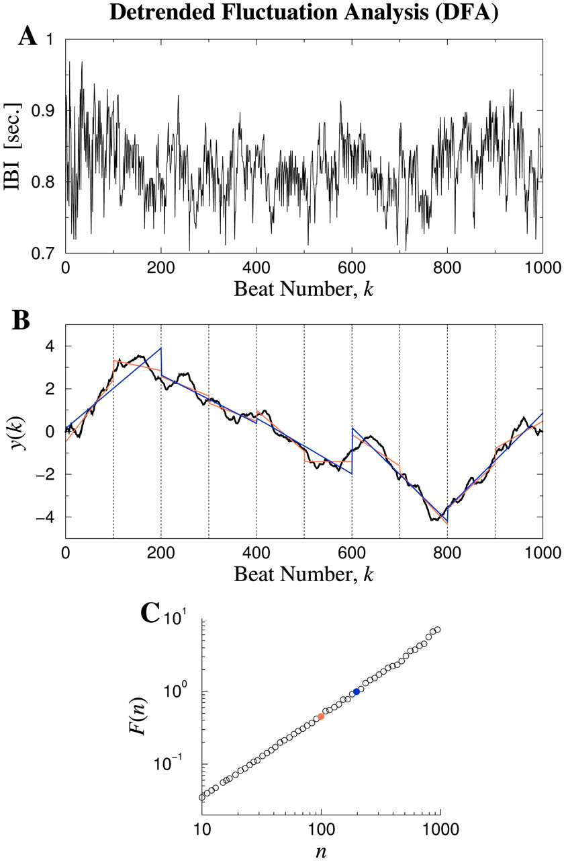
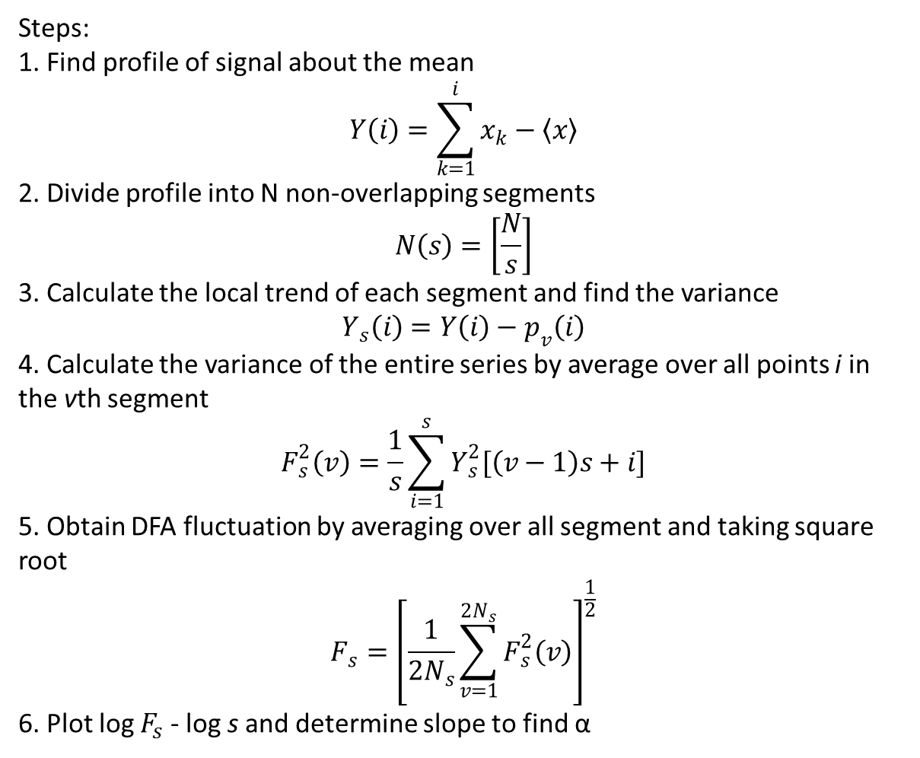
Detrended Fluctuation Analysis (DFA)
Steps:
1. Find profile of signal about the mean
$$Y\left(i\right)=\sum_{k=1}^{i}{x_{k}−〈x〉}$$
2. Divide profile into N non-overlapping segments
$$N\left(s\right)=\left[\frac{N}{s}\right]$$
3. Calculate the local trend of each segment and find the variance
$Y_{s}\left(i\right)=Y\left(i\right)−p_{v}\left(i\right)$
4. Calculate the variance of the entire series by average over all points i in the vth segment
$$F_{s}^{2}\left(v\right)=\frac{1}{s}\sum_{i=1}^{s}{Y_{s}^{2}[\left(v−1\right)s+i]}$$
5. Obtain DFA fluctuation by averaging over all segment and taking square root
$$F_{s}={\left[\frac{1}{2N_{s}}\sum_{v=1}^{2N_{s}}{F_{s}^{2}\left(v\right)}\right]}^{\frac{1}{2}}$$
6. Plot log $F_{s}$ - log s and determine slope to find α
Goldberger A L et al. PNAS 2002;99:2466-2472

Slide 14
So What’s Next?
Process the collected data with methods previously described
Look specifically at:
  Consistency of each method
  Sensitivity
  Statistical significance between certain groups within each method
    Obese vs normal BMI
    Fallers vs non-fallers and known fallers (post)
    Medications
  Statistical significance between each method to see consistency across board
QUESTIONS?

Slide 15
References
Gao J, Hu J, Buckley T, White K, Hass C (2011) Shannon and Renyi Entropies to Classify Effects of Mild Traumatic Brain Injury on Postural Sway. PLoSONE 6(9): e24446. doi:10.1371/journal.pone.0024446
Pincus, S.M. and A.L. Goldberger, Physiological time-series analysis: what does regularity quantify? American Journal of Physiology-Heart and Circulatory Physiology, 1994. 266(4): p. H1643-H1656.
Pincus, S.M., Approximate entropy as a measure of system complexity. Proceedings of the National Academy of Sciences, 1991. 88(6): p. 2297-2301.
Kantelhardt, J.W., et al., Detecting long-range correlations with detrended fluctuation analysis. Physica A: Statistical Mechanics and its Applications, 2001. 295(3): p. 441-454.
Goldberger, A.L., et al., Fractal dynamics in physiology: alterations with disease and aging. Proceedings of the National Academy of Sciences, 2002. 99(suppl 1): p. 2466-2472.
Richman, J.S. and J.R. Moorman, Physiological time-series analysis using approximate entropy and sample entropy. American Journal of Physiology-Heart and Circulatory Physiology, 2000. 278(6): p. H2039-H2049.
N. Marwan, M. C. Romano, M. Thiel, J. Kurths: Recurrence Plots for the Analysis of Complex Systems, Physics Reports, 438(5-6), 237-329, 2007

