Slide 1
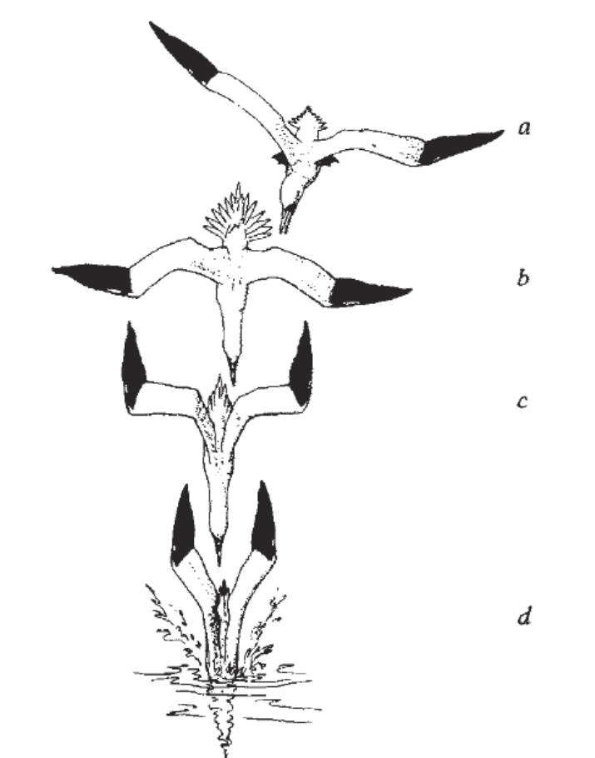
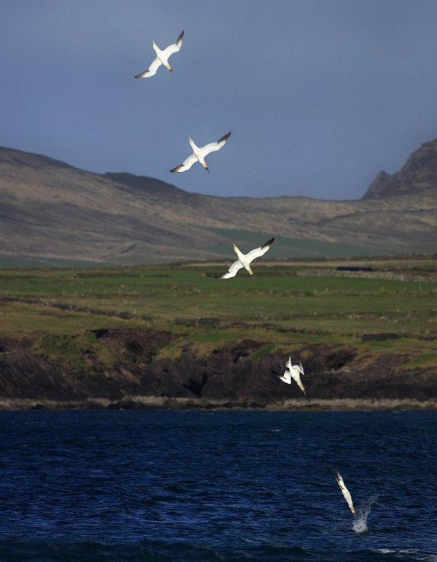
Bird Diving:
Hydrodynamics
Talia Weiss
Mentor – Sunny Jung

Slide 2
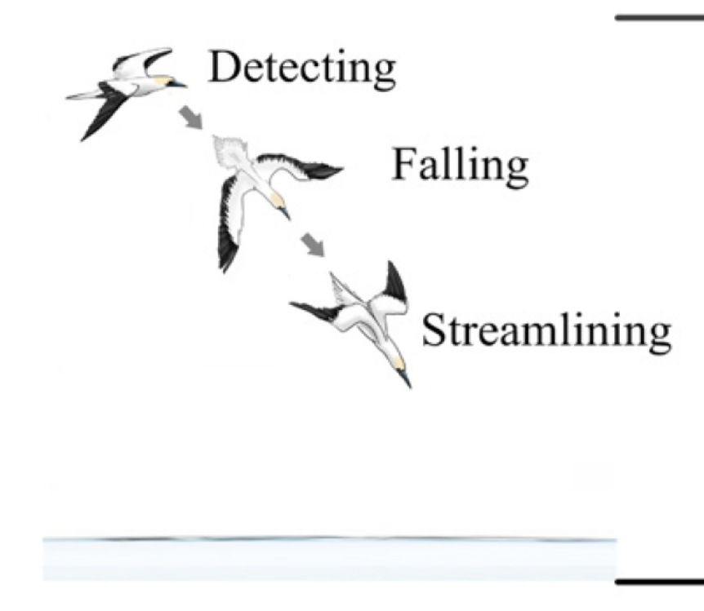
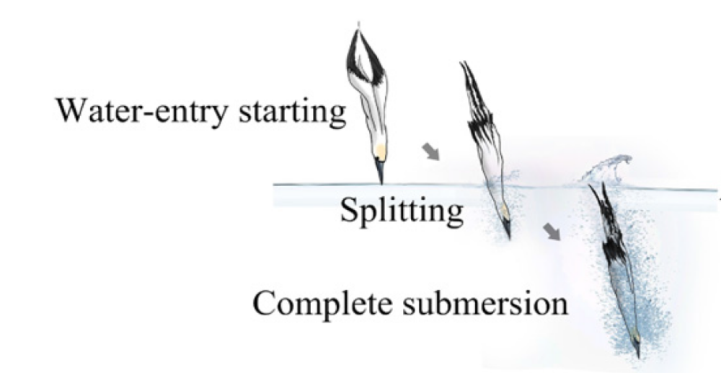
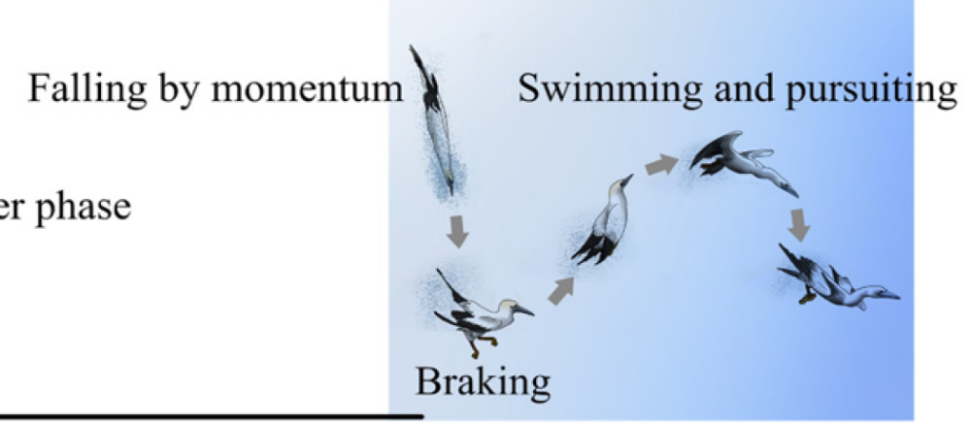
Wang, T. M., et al. "CFD based investigation on the impact acceleration when a gannet impacts with water during plunge diving." Bioinspiration & biomimetics 8.3 (2013): 036006.

Slide 3
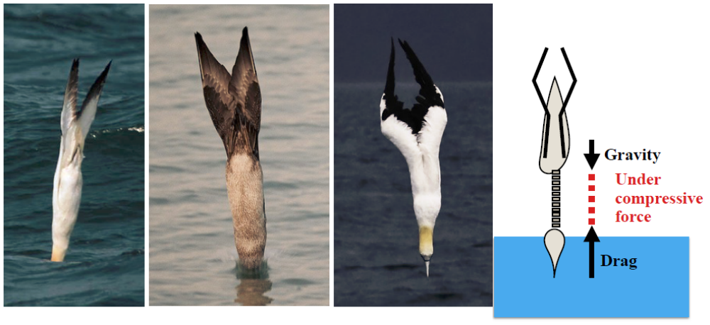
25 m/s
3 m/s
Can the forces involved in diving be enough to cause the neck injury?
What ARE the forces anyway?

Slide 4
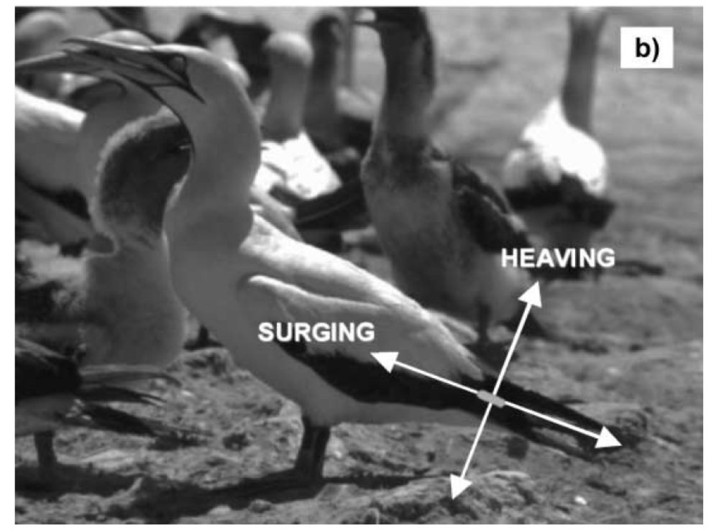
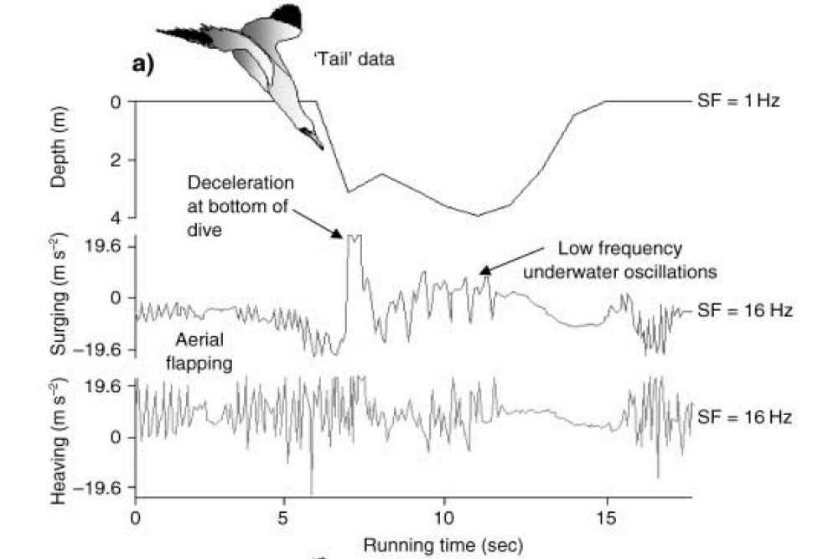
Currently Conflicting Information
accelerometer
Ropert‐Coudert, Yan, et al. "Between air and water: the plunge dive of the Cape Gannet Morus capensis." Ibis 146.2 (2004): 281-290.

Slide 5
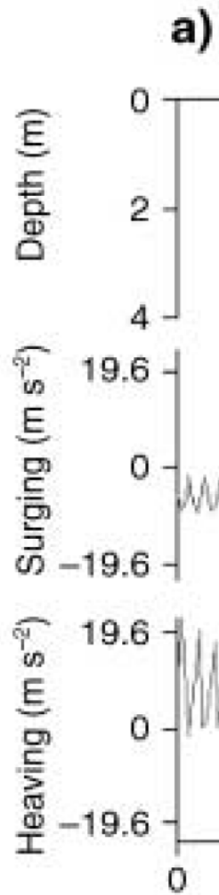
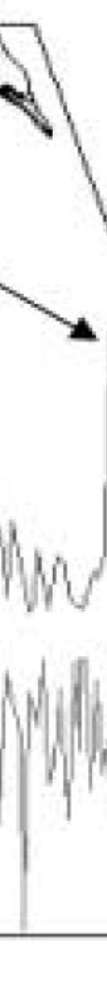
“ absence of rapid deceleration recorded when birds hit the water surface….”
However, diving speed of Gannet hitting the water up to speeds of 24 m/s , however, recorded underwater speed in paper is ~3 m/s, and underwater descent only 1.36 sec. So some deceleration had to happen when bird hits surface

Slide 6
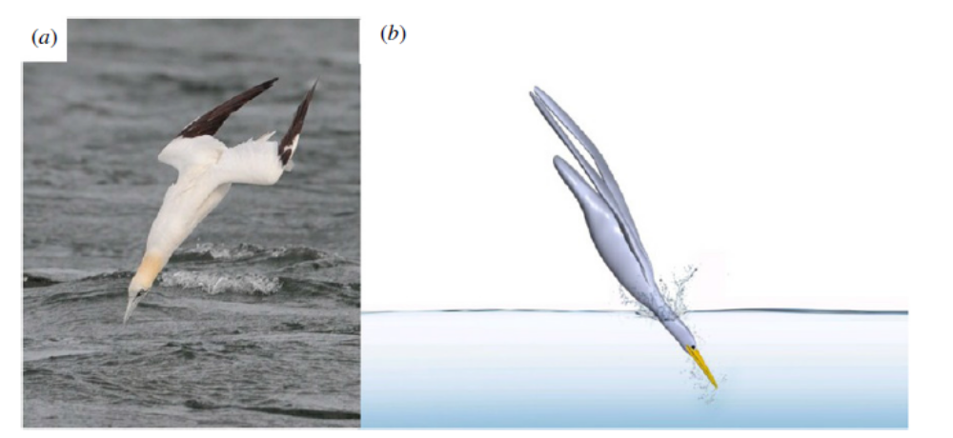
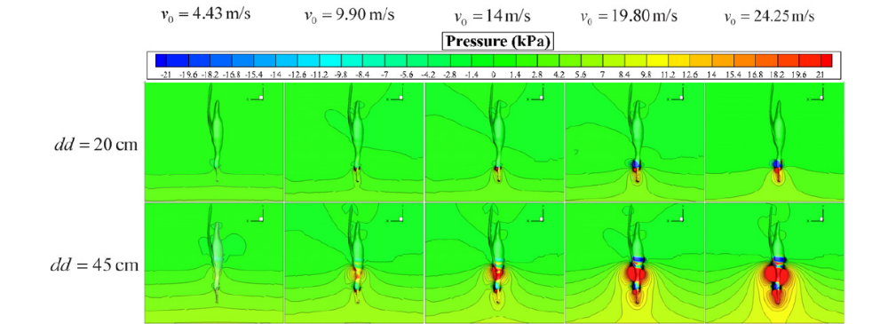
CFD
Model
Wang, T. M., et al. "CFD based investigation on the impact acceleration when a gannet impacts with water during plunge diving." Bioinspiration & biomimetics 8.3 (2013): 036006.

Slide 7
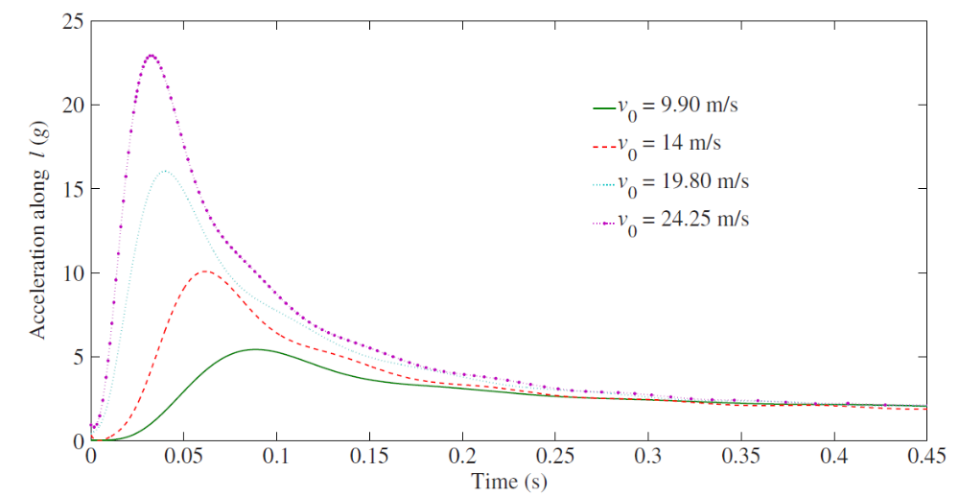
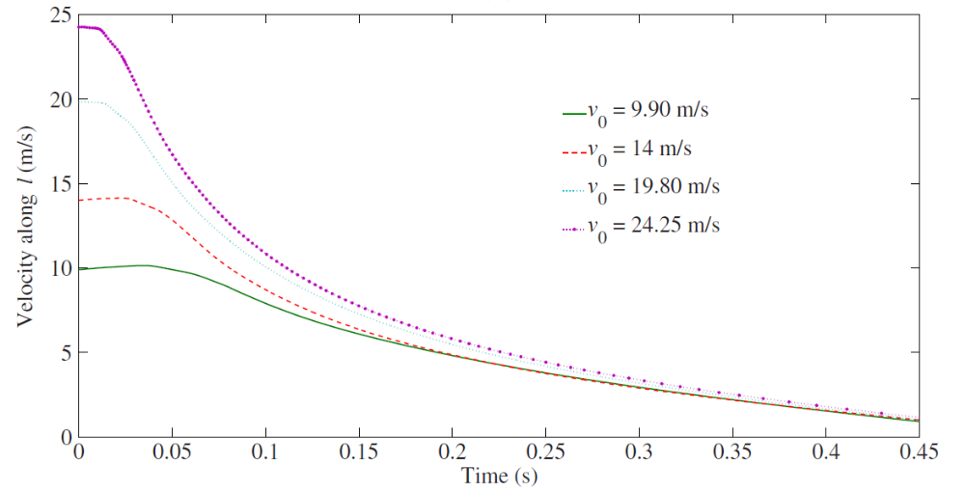
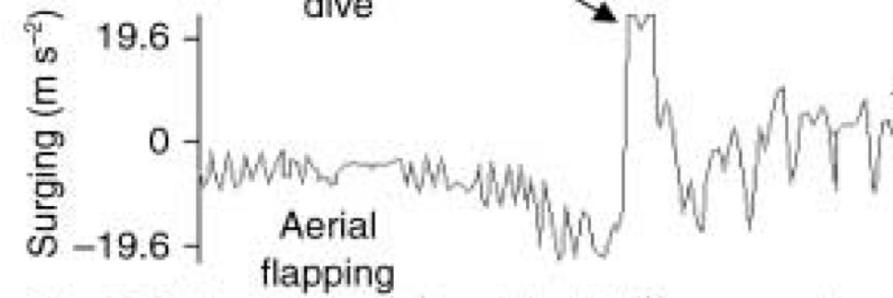
Model shows large deceleration within finished within 0.1 seconds of impact.
This could easily be missed/ignored as noise for the sampling frequency of 32 Hz (1 sample every .03 seconds, so 3 samples taken within the yellow region on left)

Slide 8
Another inconsistency is whether the bird is decelerating during the dive after the initial impact….experiments are noisy but claim no, models show small constant deceleration after the first 0.1 seconds.

Slide 9
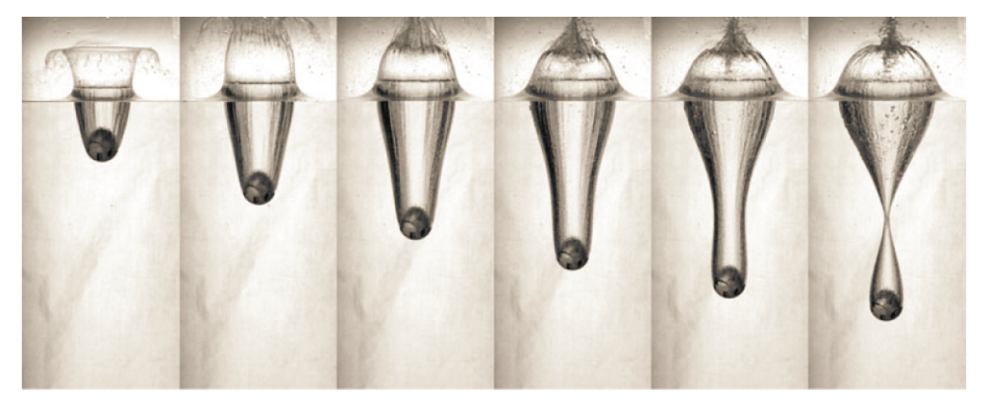
Objectives
Try and gain intuition with simpler models in order to match experimental data with theory
Truscott, Tadd T., Brenden P. Epps, and Alexandra H. Techet. "Unsteady forces on spheres during free-surface water entry." Journal of Fluid Mechanics 704 (2012): 173-210.

Slide 10
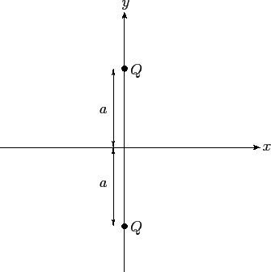
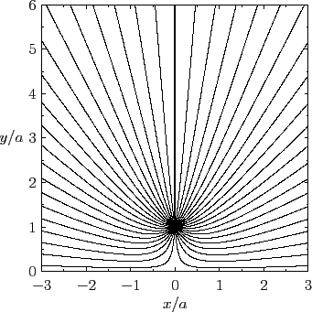
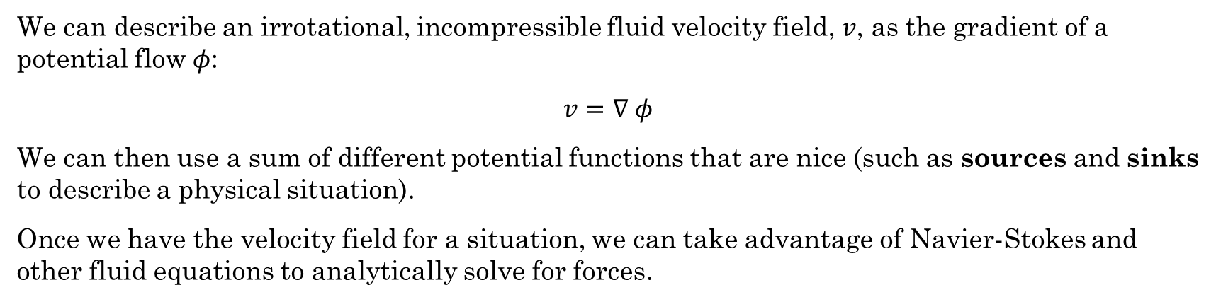
Potential flow models/method of images
We can describe an irrotational, incompressible fluid velocity field, $v$, as the gradient of a potential flow $φ$:
$$v=∇ φ$$
We can then use a sum of different potential functions that are nice (such as sources and sinks to describe a physical situation).
Once we have the velocity field for a situation, we can take advantage of Navier-Stokes and other fluid equations to analytically solve for forces.

Slide 11
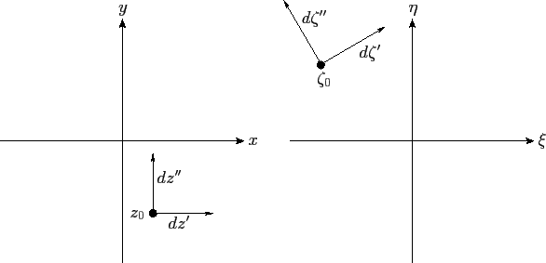
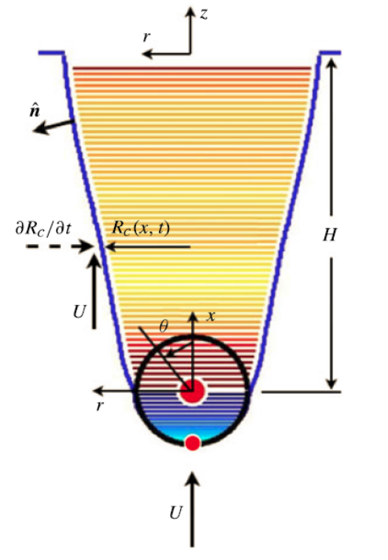
Combine with conformal mapping
Using conformal mapping, one can map a simple, shape to a complex shape using a mapping function (that can be analytically or numerically derived).
This map can then be used on the simple velocity field to get the velocity field for the more complex geometry
?

Slide 12
Conformal mapping
Conformal mapping is very limited in 3D due to Liouville’s theorem –
Essentially only Mobius transformations (translations, similarities, inversions, and orthogonal transformation) allowed in 3D
?
So let’s examine the 2D problem to see if we can get anywhere:

Slide 13





So how to we get the velocity field around a wedge? – Conformal map the real line
MAP!
$$z_{1} z_{2} z_{3} z_{4} z_{5}$$
$$w_{1} w_{2}$$
$$w_{4} w_{5}$$
$$w_{3}$$
Z-plane
$$ξ−plane$$

Slide 14
Why this shape is important
Air-water
interface
beak
Time 1
Time 2
Time 3

Slide 15
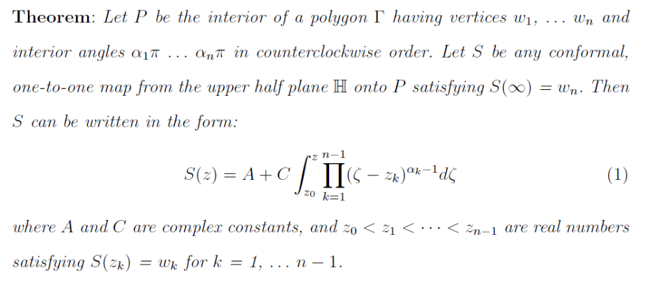
Schwartz-Christoffel Transform
There is a closed form, analytical solution from mapping the real line to any polygon – including those with infinite vertices
Bergonio, Philip Palma. Schwarz-Christoffel transformations. Diss. uga, 2007.

Slide 16

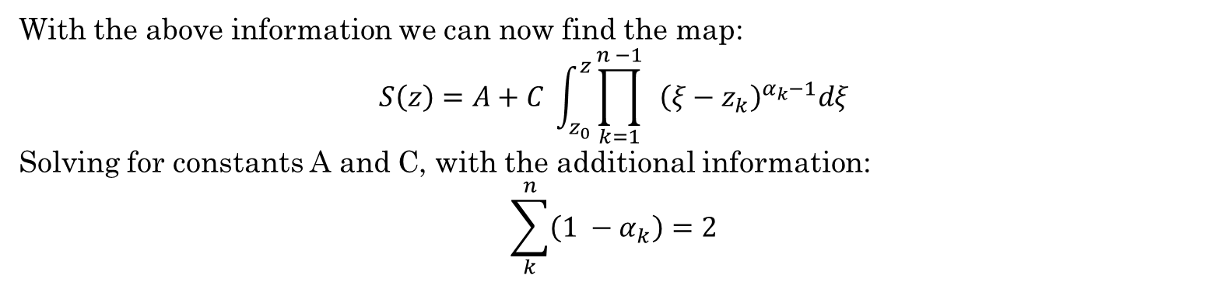


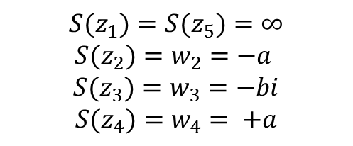

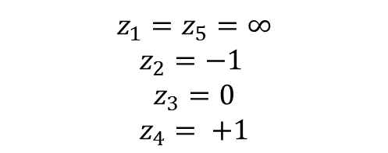





2a
$$πα_{1}$$
$${πα}_{2}$$
$${πα}_{4}$$
$${πα}_{5}$$
$$z_{1} z_{2} z_{3} z_{4} z_{5}$$
$$w_{1} w_{2}$$
$${πα}_{3}$$
$$w_{4} w_{5}$$
$$z_{1}=z_{5}=∞$$
$$z_{2}=−1$$
$$z_{3}=0$$
$$z_{4}= +1$$
$${S(z}_{1})={S(z}_{5})=∞$$
$${S(z}_{2})=w_{2}=−a$$
$${S(z}_{3})=w_{3}=−bi$$
$${S(z}_{4})=w_{4}= +a$$
b
$$w_{3}$$
With the above information we can now find the map:
$$S\left(z\right)=A+C \int_{z_{0}}^{z}{{\prod_{k=1}^{n −1}{ }\left(ξ−z_{k}\right)}^{α_{k}−1}dξ}$$
Solving for constants A and C, with the additional information:
$$\sum_{k}^{n}{\left(1 −α_{k}\right)=2}$$

Slide 17
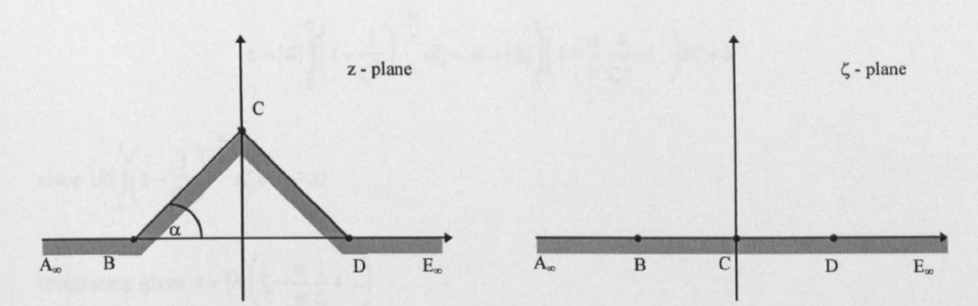
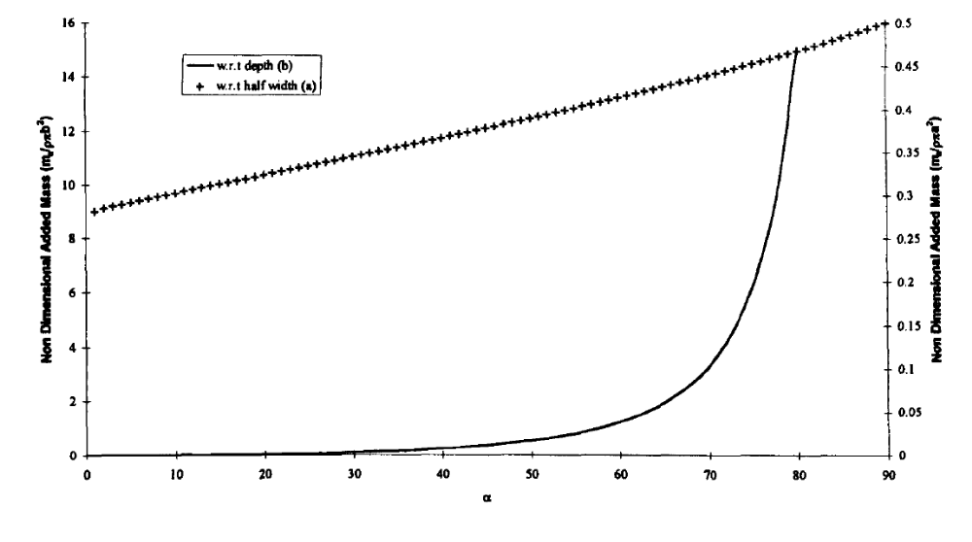
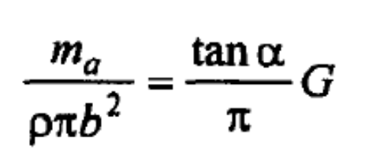

$$m_{a}∝b^{2}$$
Barringer, Ian Edward. "The hydrodynamics of ship sections entering and exiting a fluid." School of Information Systems, Computing and Mathematics (1998).).
Wedge half angle

Slide 18
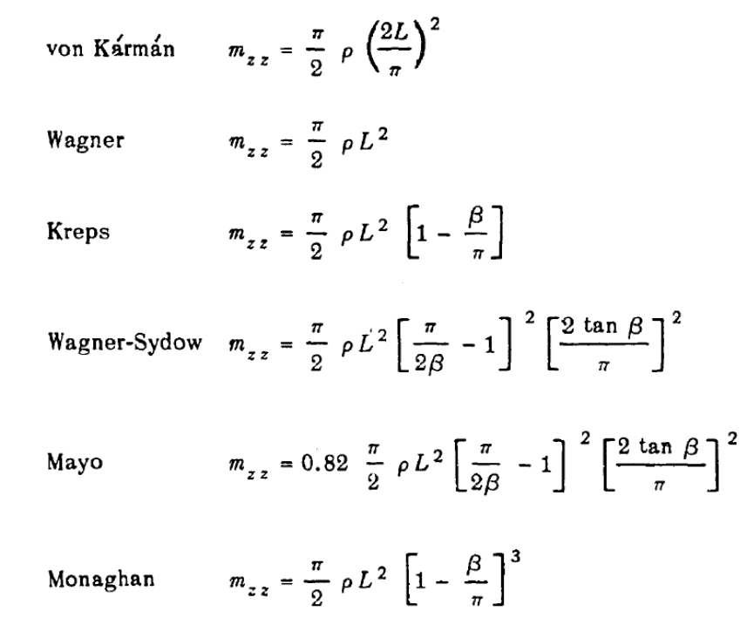
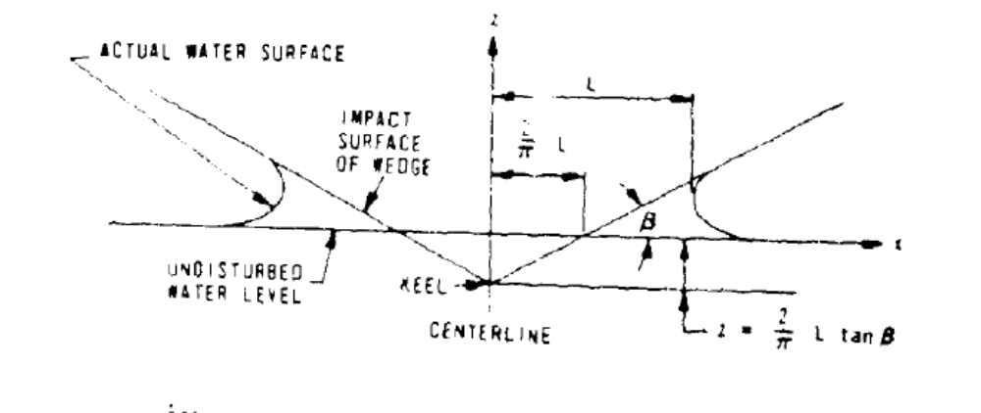
Future work
Use mapping equation to calculate added mass from the wedge (see Appendix B of (Barringer, Ian Edward. "The hydrodynamics of ship sections entering and exiting a fluid." School of Information Systems, Computing and Mathematics (1998).).
Use other ship/hull slamming relation estimations to try and measure pressure and impact forces
What forces does the bird care about most?
Chuang, Sheng-Lun. Slamming of rigid wedge-shaped bodies with various deadrise angles. No. DTMB-2268. DAVID TAYLOR MODEL BASIN WASHINGTON DCSTRUCTURAL MECHANICS LAB, 1966.

