Slide 1
Critical Transitions
Midterm Report
Keith Heyde

Slide 2
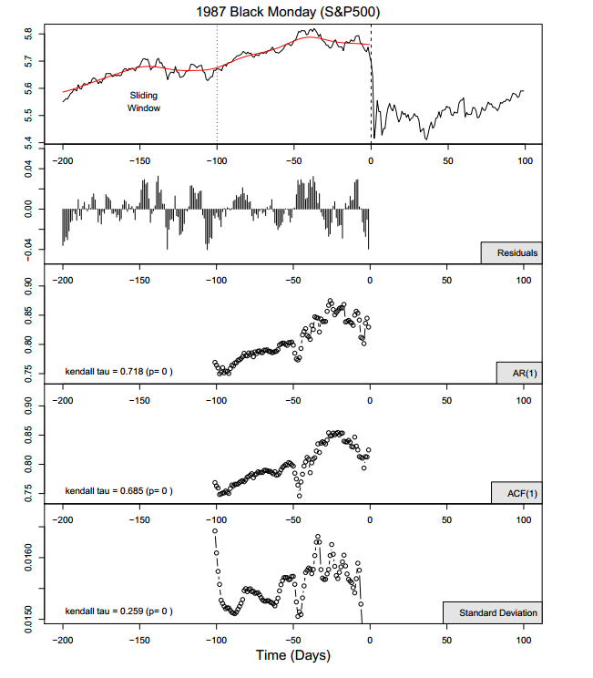
Diks et al. 2012

Slide 3
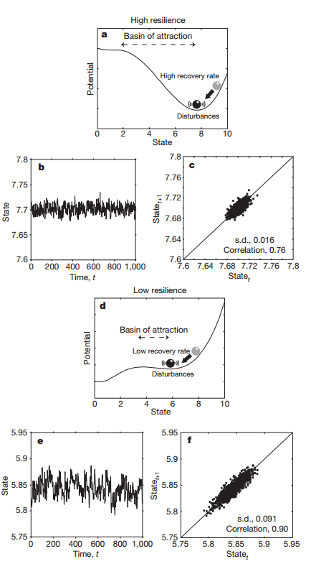
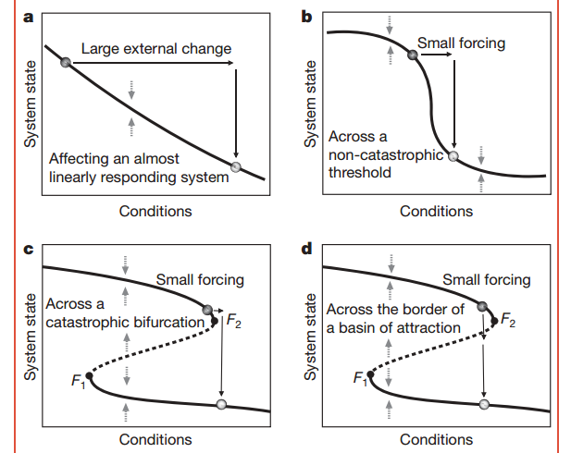
What Are Critical Transitions?

Slide 4
Early Warning Signs
Critical Slowing
Asymmetry of Fluctuation
Flickering (with stochastic magnitude)

Slide 5
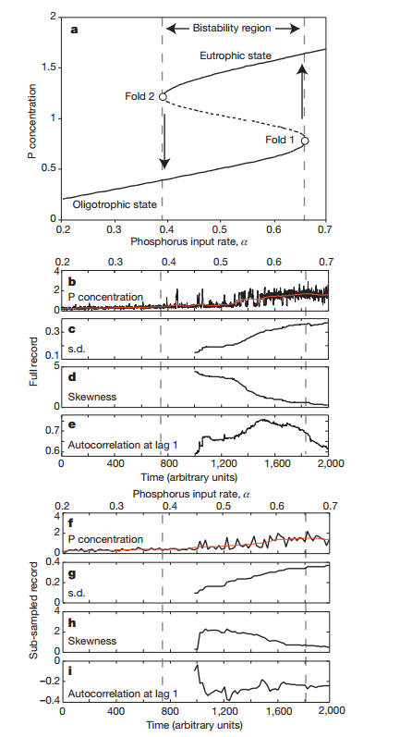
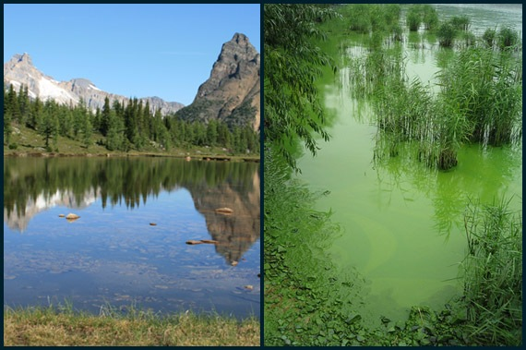
Predicting Critical Transitions: Case Study
Lake Eutrophication
Wang et al. 2012

Slide 6
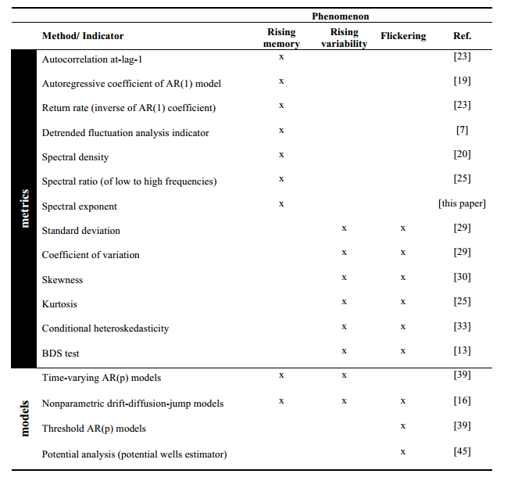
Critical Slowing
Slow Perturbation Recovery
Increased autocorrelation
Increased Variance
- The focus of my analysis thus far has been identifying critical slowing in certain metrics

Slide 7
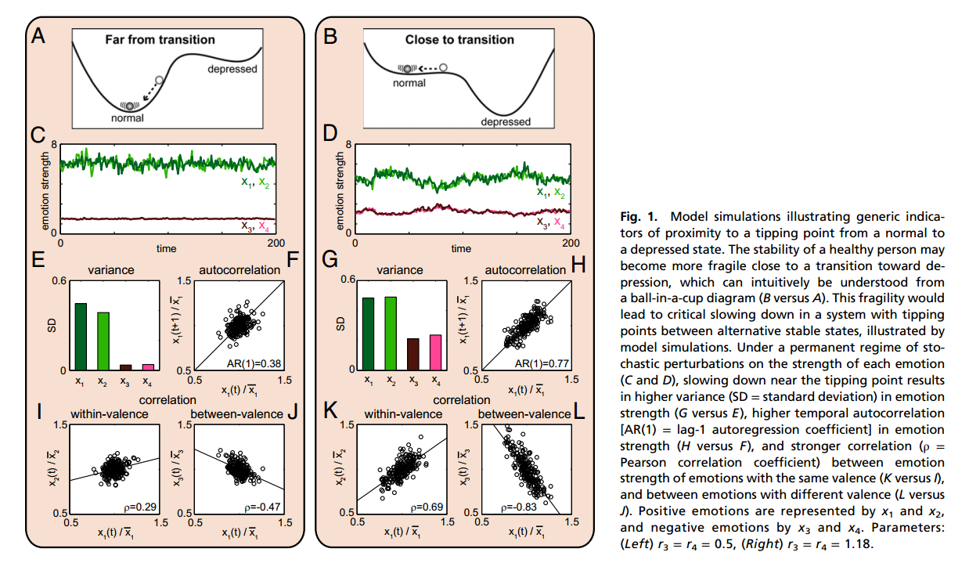
Previous Successful (Published) Examples
Stock Market (mixed results)
Climate – Flickering and critical slowing at Younger Dryas Cold Period
Ecosystems- Vegetation and Desertification
Agri/Aquaculture- Fishing stocks
Neurological- Epilepsy/ Depression
Leemput et al. 2013

Slide 8
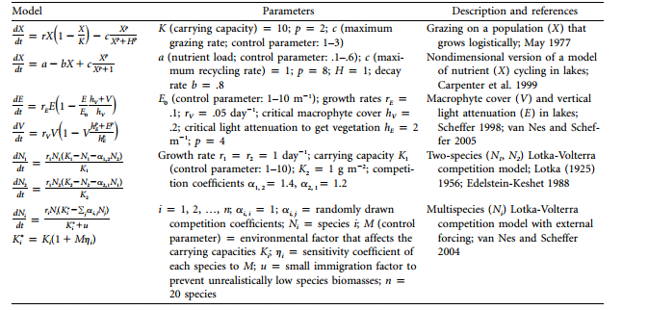
Methods Pursued
Find Sample Data
If smooth add noise (matlab)
Examine autocorrelation and skewness
If ‘stochastic’ leave as is
Understand potential chaotic drop
Examine autocorrelation and skewness

Slide 9
Examples Pursued
Splitting States
Nationalization/Privatization of Industry
- Mining in Chile
- Oil Reserves in Latin America (country by country)
Venture capital Investment patterns by industry
In all cases data was taken from The Economist (in turn taken from primary sources)

Slide 10
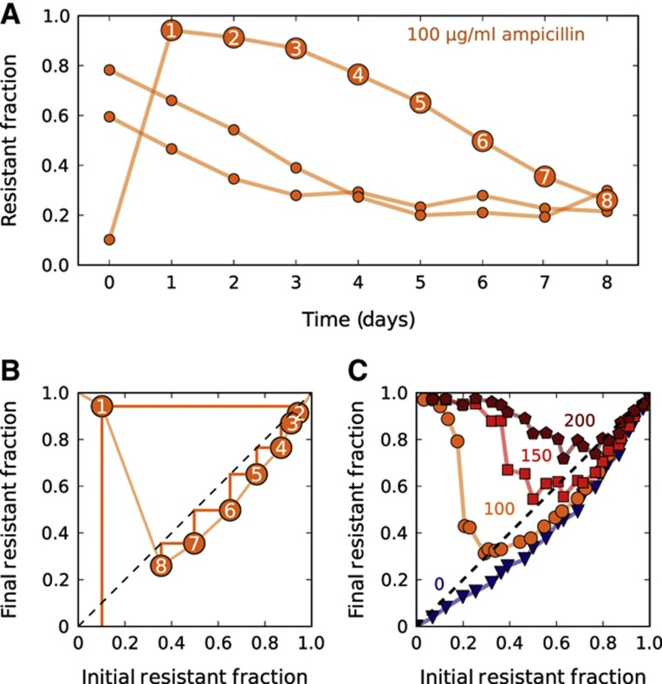
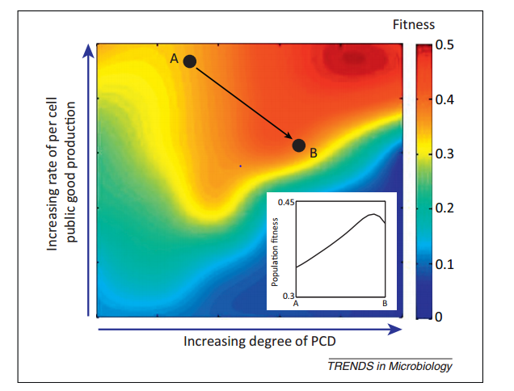
Moving forward:
Predicting Antibiotic Resistance
Normal (mutation) Death Response
Altruistic Death Response
Yurtsev et al.

Slide 11
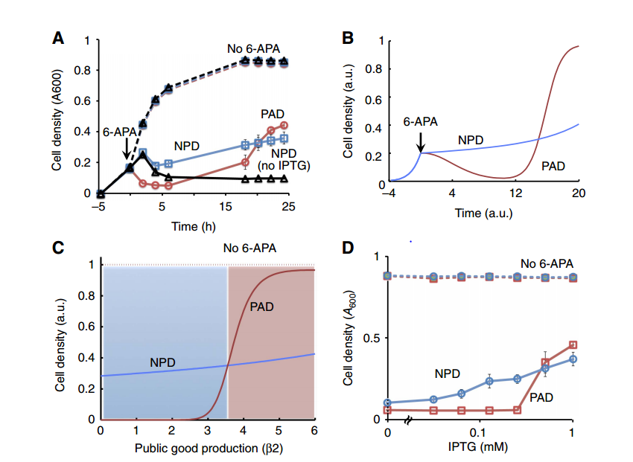
Moving Forward Cont..
Parameters: public good production (B2)
Multiple equilibria (including zero)
Sample data processing within MATLAB (autocorrelation and variance analysis)
Tanouchi et al. 2012

Slide 12
Have a Great Day!
And thanks to Prof. Ross for all the help!

